Slide 1
CT with Privacy EN.601.745 Advanced Topics in Applied Cryptography
Kandarp Khandwala, Antara Sargam

Slide 2
Problems due to Certificate Mis-issuance
MITM
Misbehavior by CAs
CA can be subverted

Slide 3
Solutions
ARPKI
Key Pinning
CAA Record
DANE
Perspectives
Country specific restrictions

Slide 4
Solutions
Solutions
ARPKI
Key Pinning
CAA Record
DANE
Perspectives
Country specific restrictions

Slide 5
ARPKI
Certificate issuance, update, revocation, and validation, are transparent and accountable
Resilience against impersonation attacks that involve n − 1 compromised entities
Detect domain compromise and take action
https://www.scion-architecture.net/pdf/2014-ARPKI.pdf

Slide 6
Solutions
Solutions
ARPKI
Key Pinning
CAA Record
DANE
Perspectives
Country specific restrictions

Slide 7
Key Pinning (HPKP)
Associate a specific cryptographic public key with a certain web server.
Public key is wrapped into a X.509 certificate.
Circumvent MITM by telling the client which public key belongs to a certain web server.
Only requires configuring an HTTP header
But Trust on First Use (TOFU)
Non web-browser HTTP clients
Misconfiguration lead to DoS

Slide 8
Solutions
Solutions
ARPKI
Key Pinning
CAA Record
DANE
Perspectives
Country specific restrictions

Slide 9
CAA Record
Allow domain owners to declare which certificate authorities are allowed to issue a certificate for a domain.
Domain owners are in control of the configuration.
Limited support from DNS providers

Slide 10
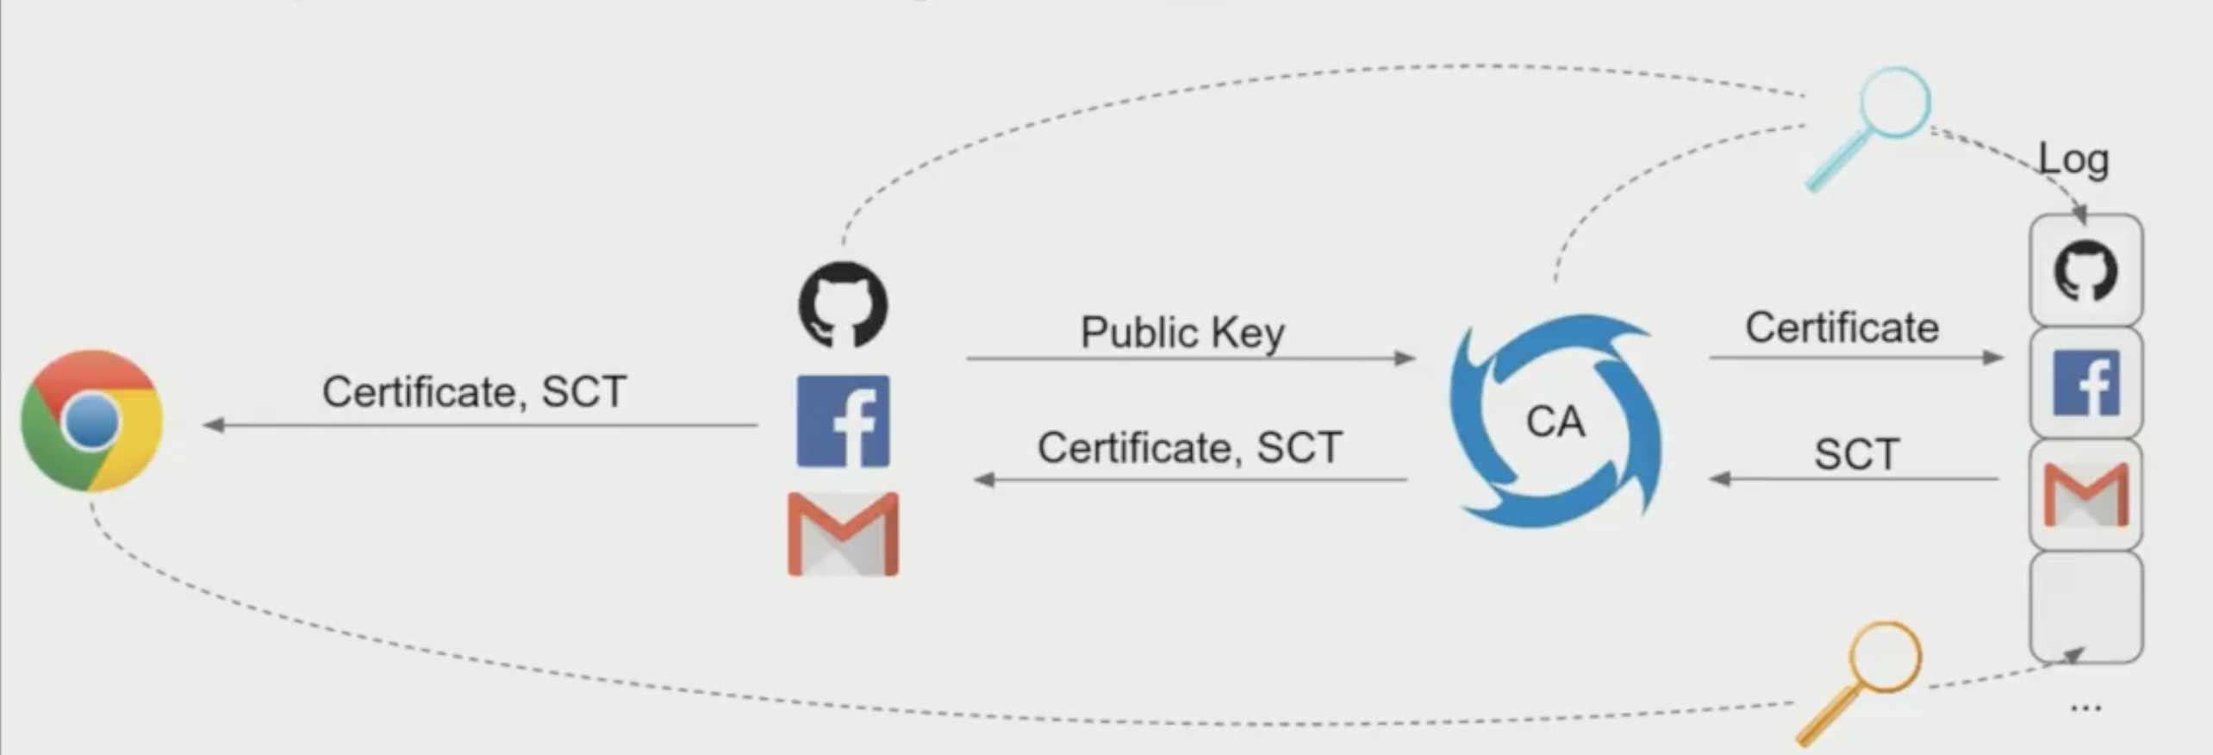
Certificate Transparency

Slide 11
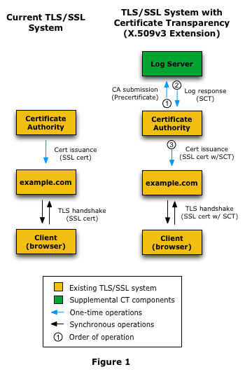

Slide 12
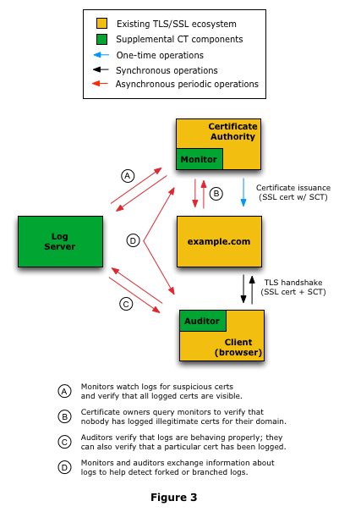
Certificate Transparency
Monitor: Watch and verify logs for suspicious certs.
Certificate owners: Query monitors to verify certs for their domain.
Auditors: Verify logs are behaving properly.

Slide 13
Certificate Transparency
Certificate Transparency
De facto data source for monitoring the PKI
Public, cryptographically verifiable ledgers of all browser-trusted certificates
Logging certificates at the time of issuance
Chrome will CT logging for browser trust in the future
Not Private
Incompatibility with private subdomains

Slide 14
Privacy concerns
Privacy Concerns
A browser (auditor) must send the offending SCT to the verifier, thereby revealing a user's browsing history.
Because domain names are publicly available in the CT log, logging certificates will reveal a servers' private domains.
Short-lived certificates.

Slide 15
Threat Model
Threat Model
Private Sub Domain
Audit a CT log without violating user privacy

Slide 16
Threat Model
Threat Model
Private Sub Domain
Audit a CT log without violating user privacy

Slide 17
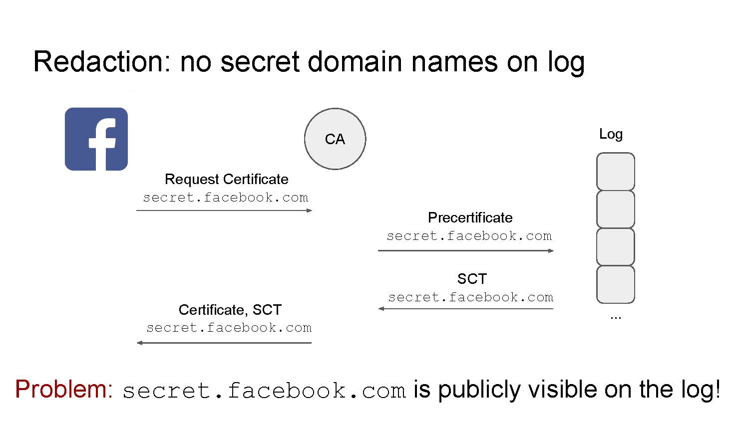
Private Subdomains

Slide 18
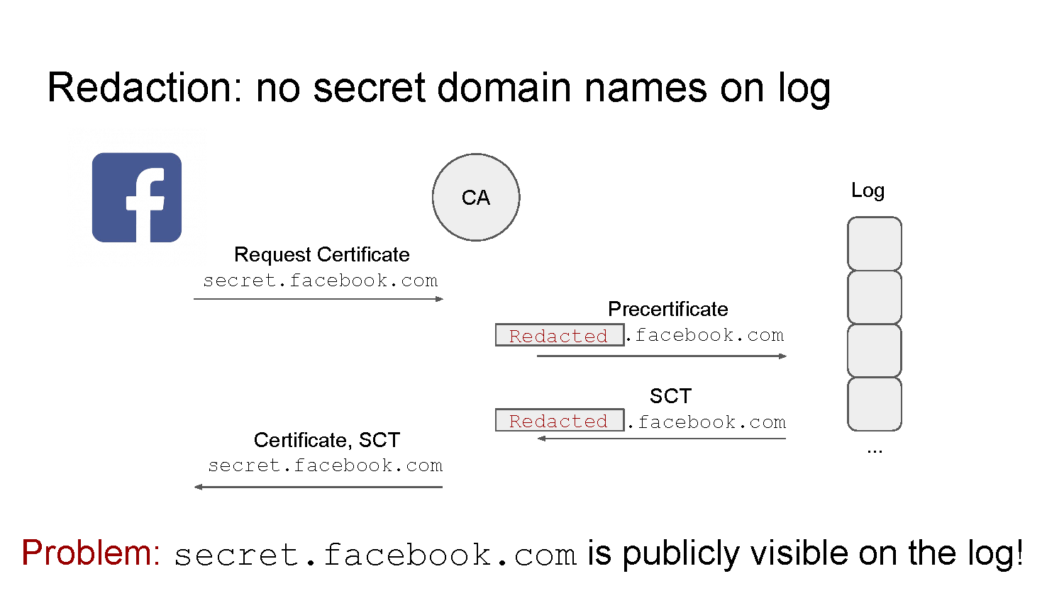
Private Subdomains

Slide 19
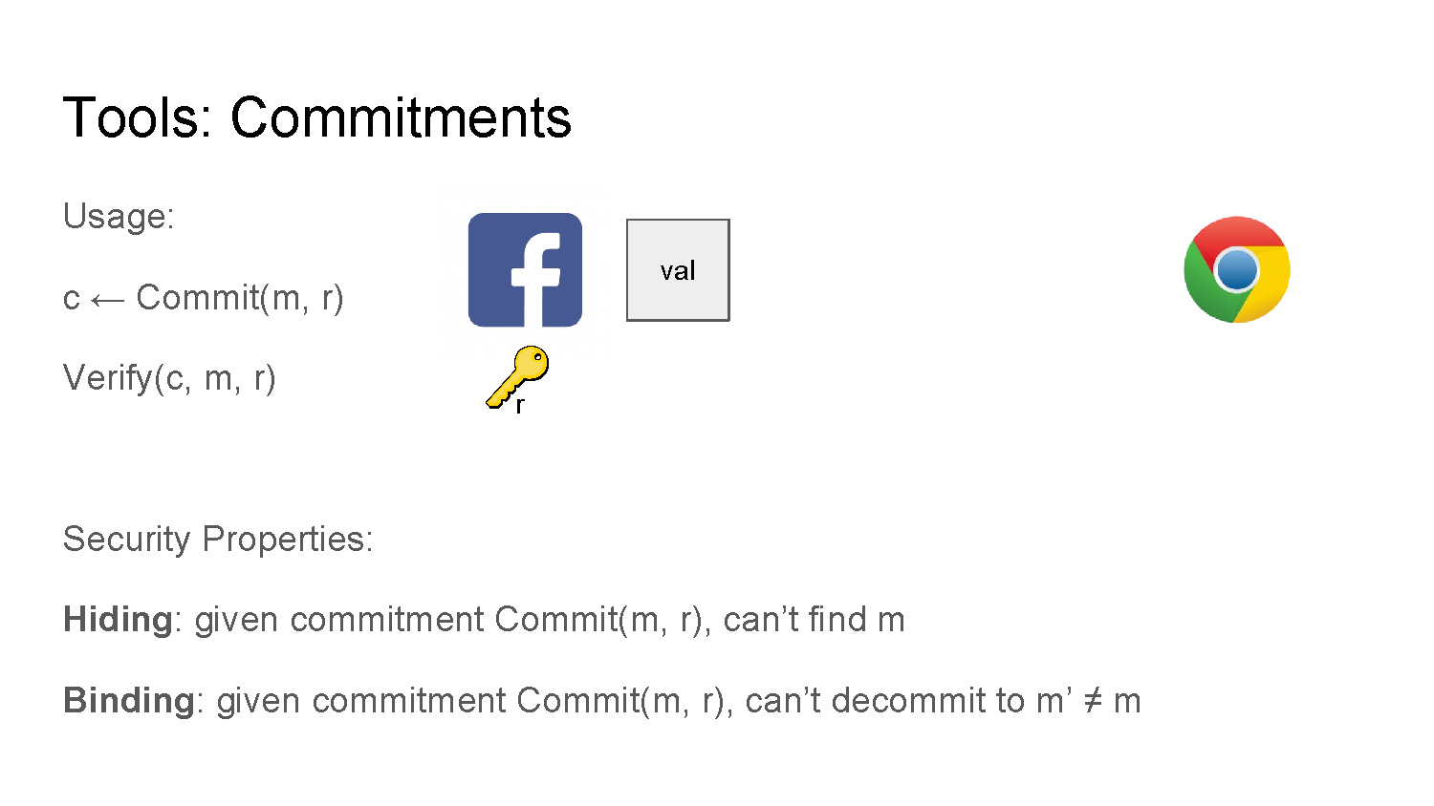
Commitments

Slide 20
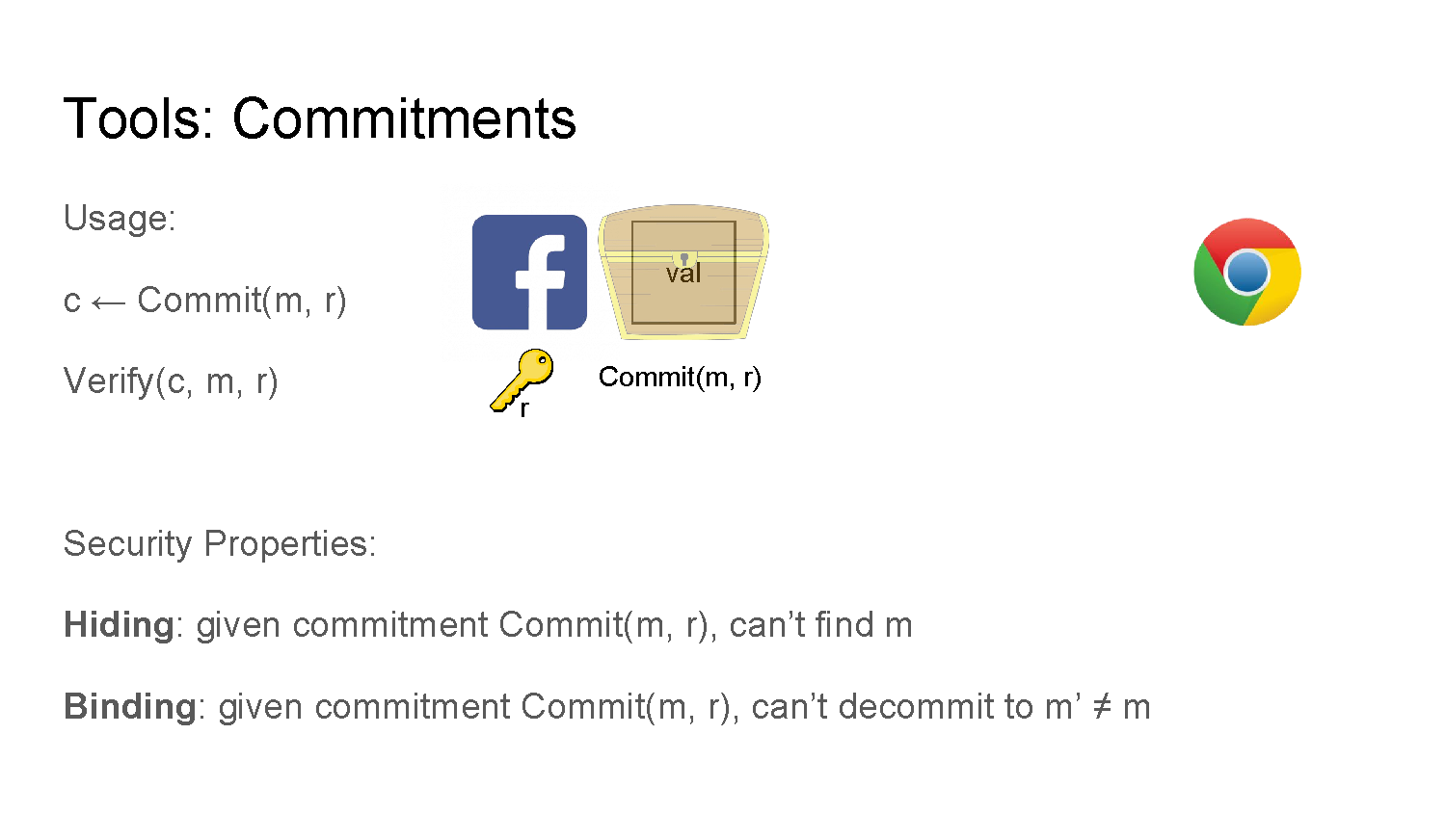
Commitments

Slide 21
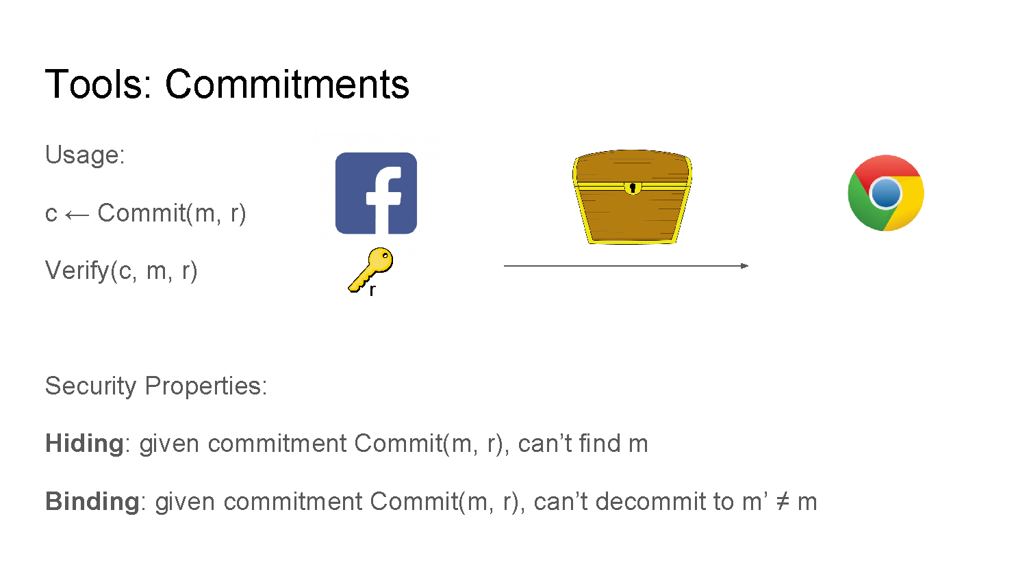
Commitments

Slide 22
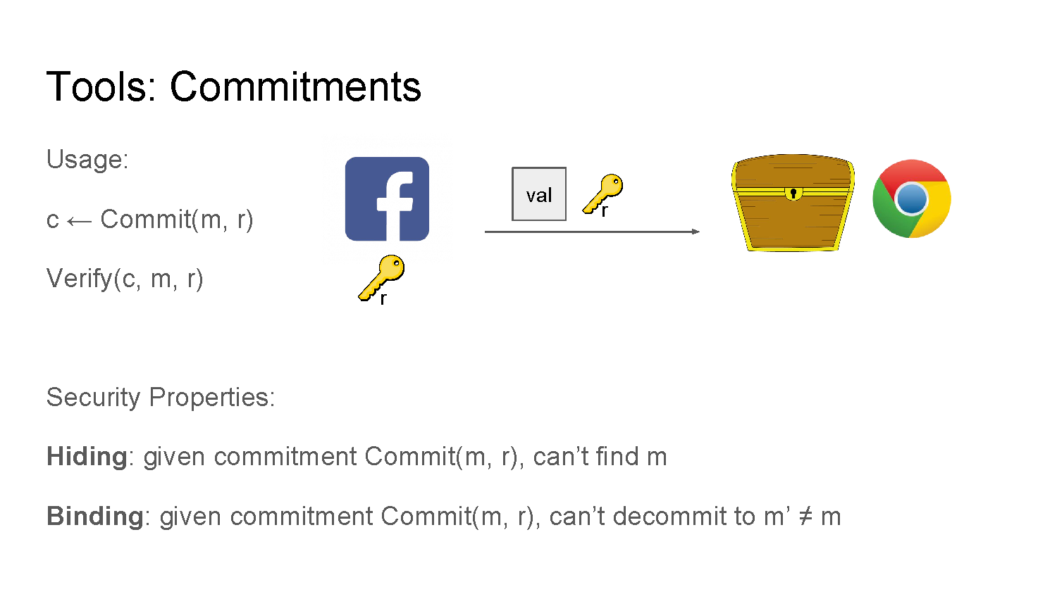
Commitments

Slide 23
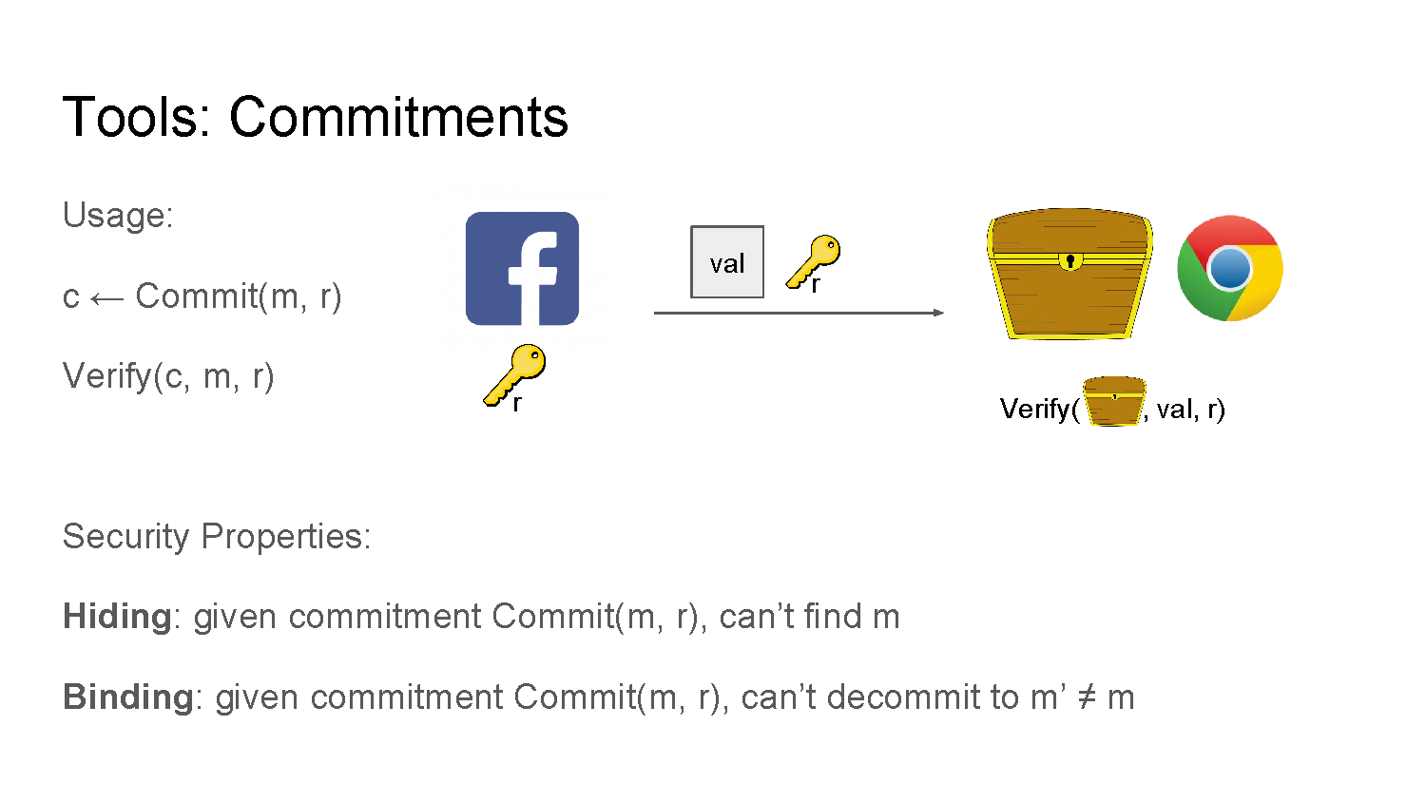
Commitments

Slide 24
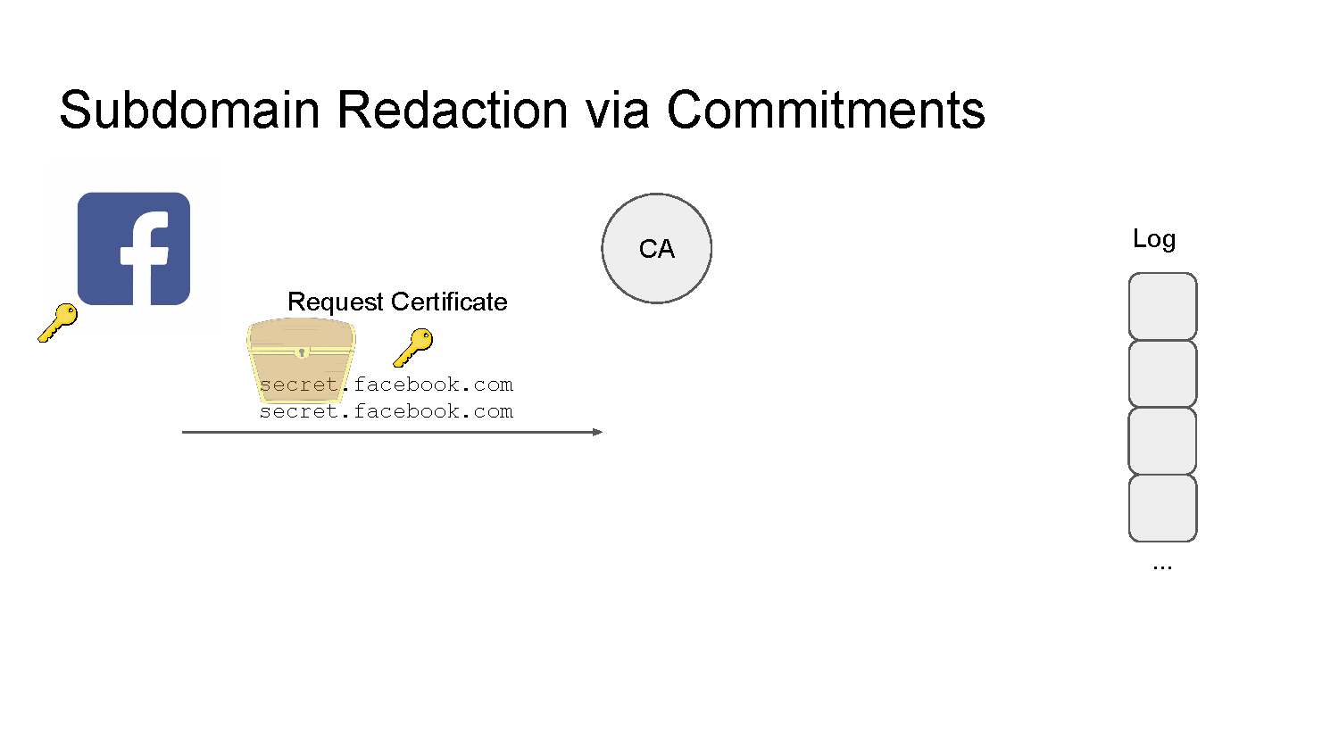
Private Sub Domains with Commitments

Slide 25
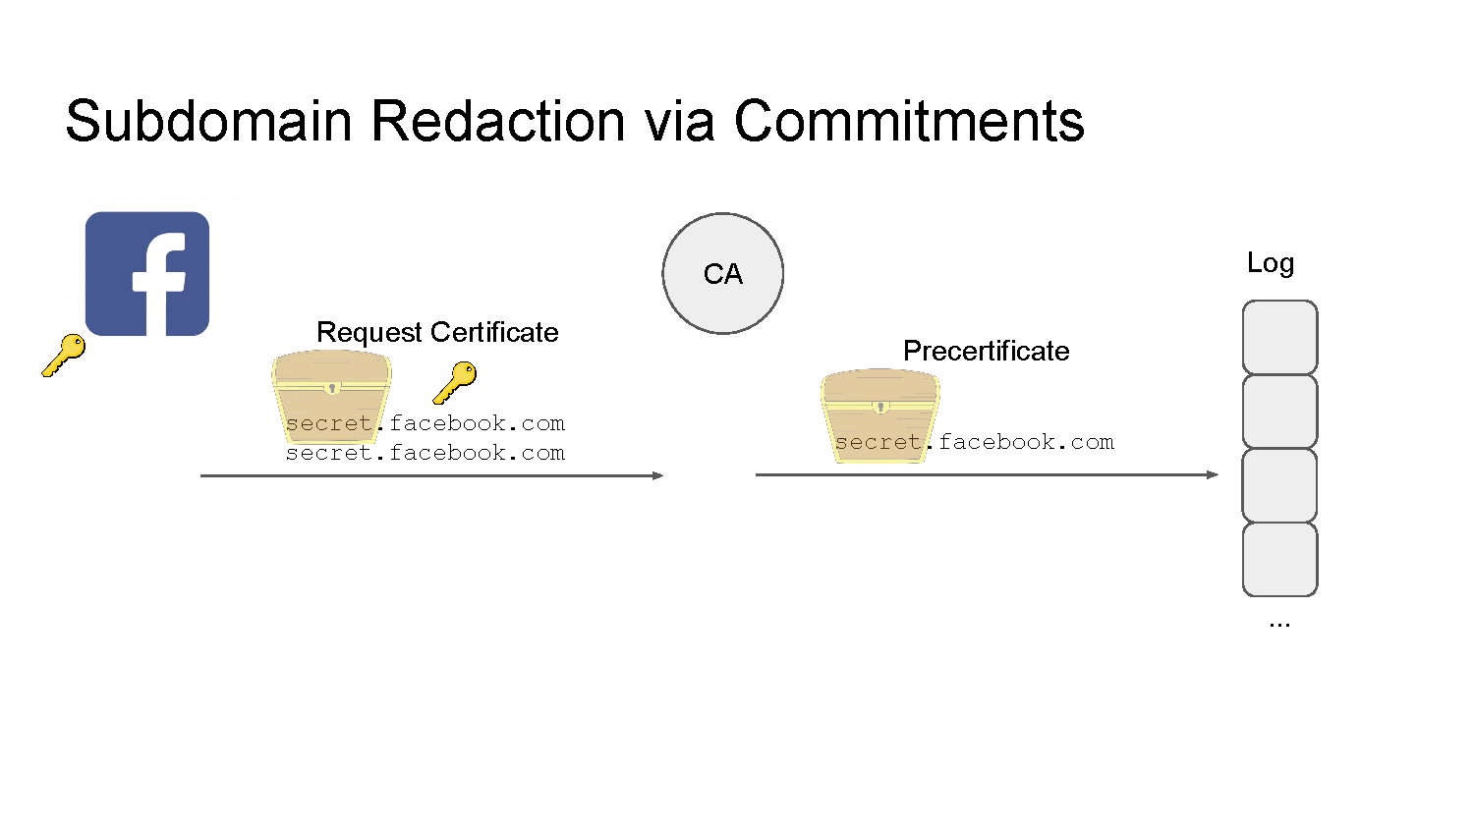
Private Sub Domains with Commitments

Slide 26
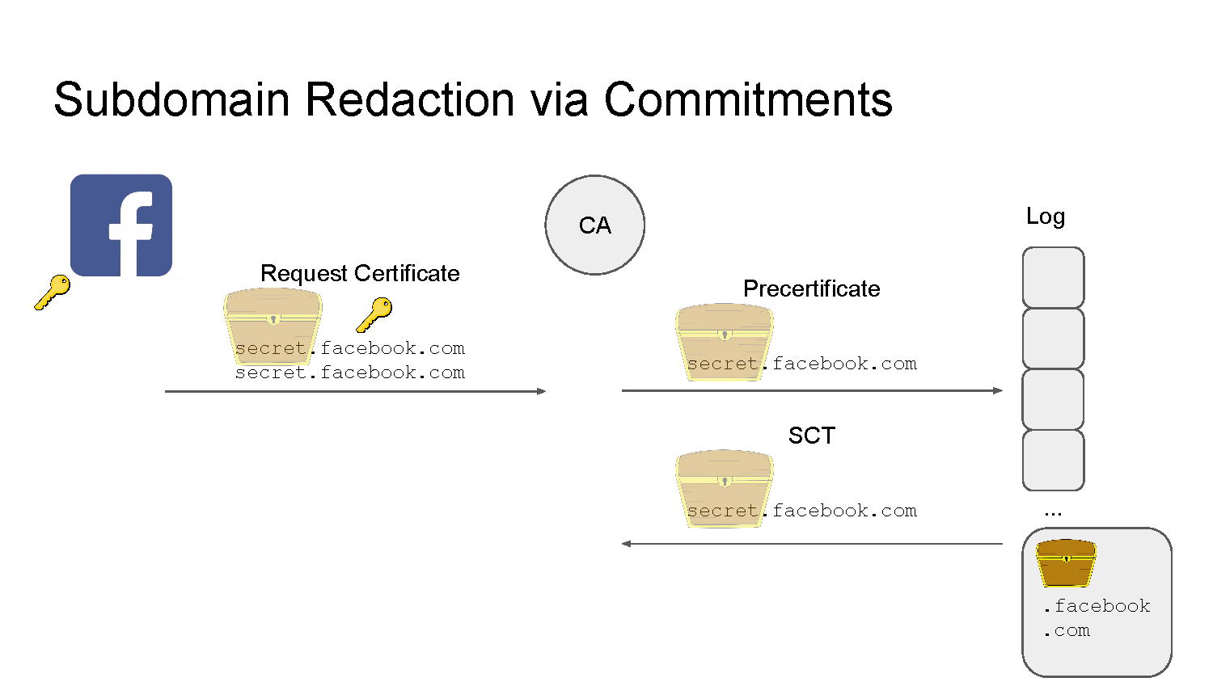
Private Sub Domains with Commitments

Slide 27
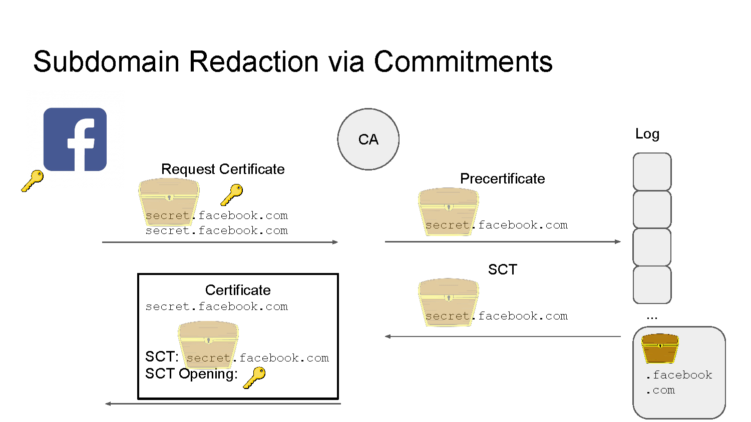
Private Sub Domains with Commitments

Slide 28
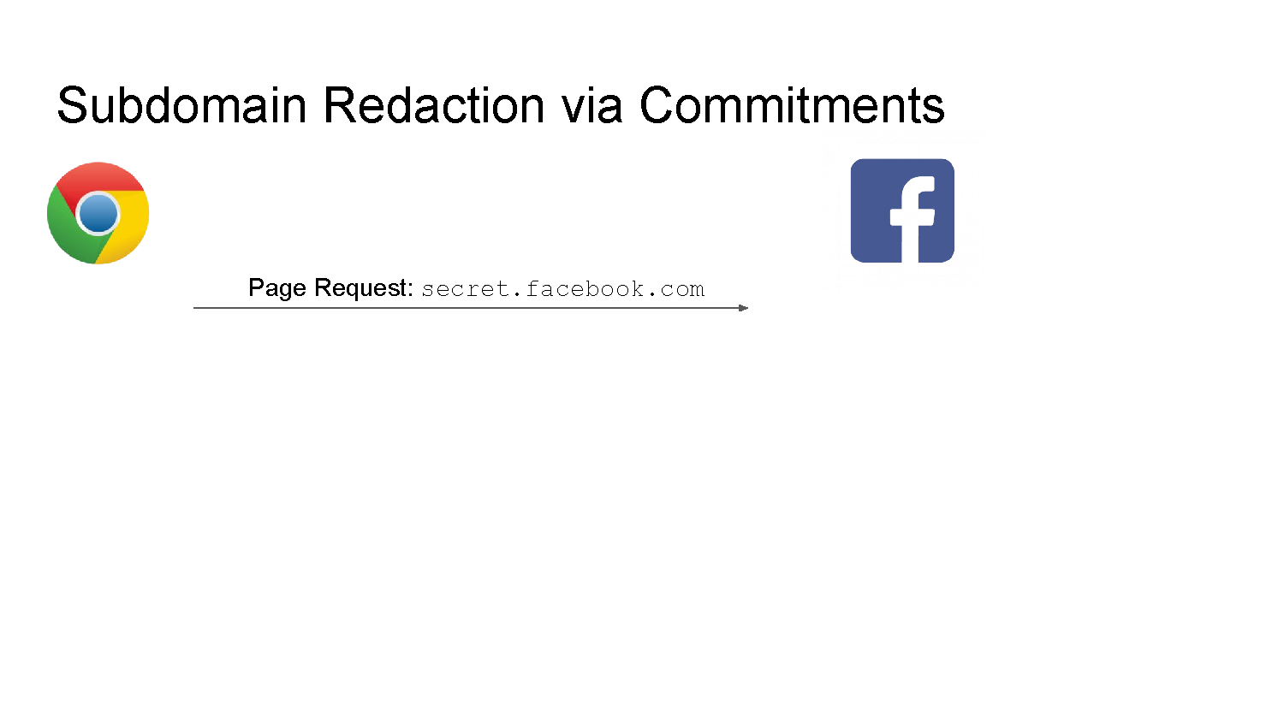
Private Sub Domains with Commitments

Slide 29
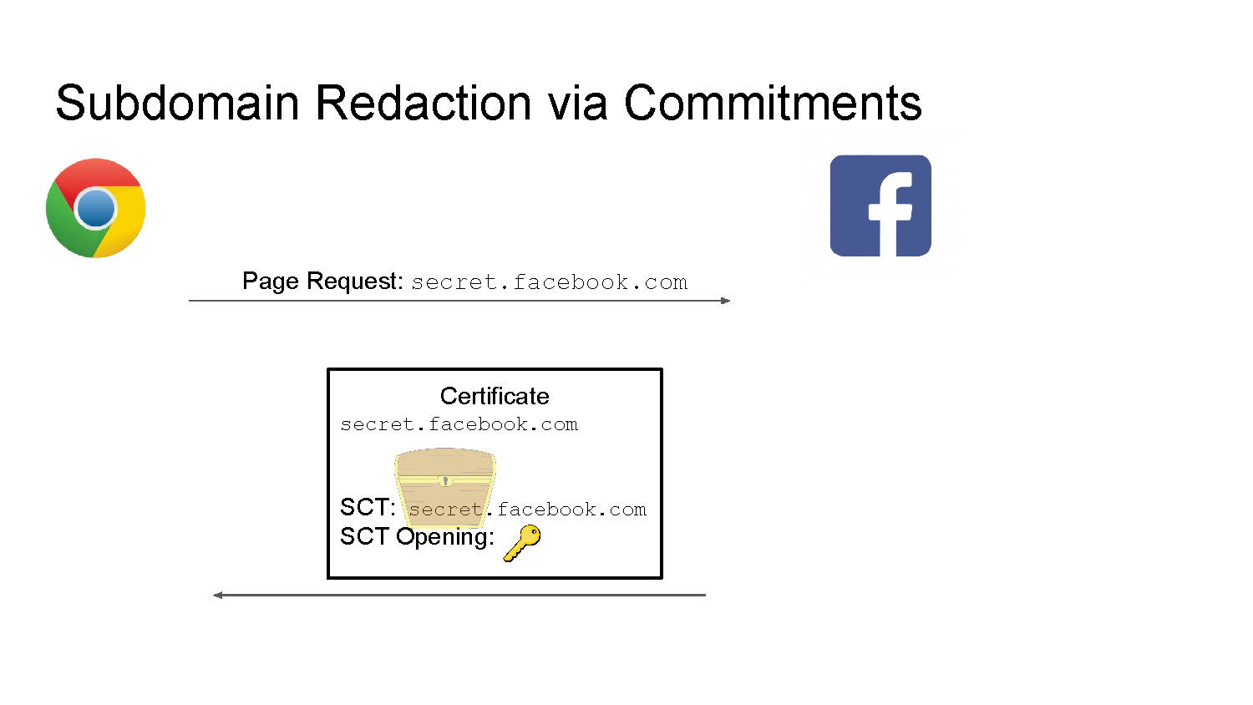
Private Sub Domains with Commitments

Slide 30
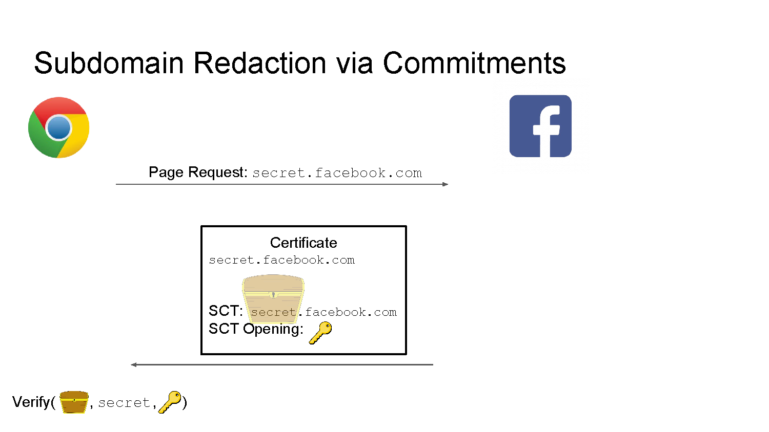
Private Sub Domains with Commitments

Slide 31
Security
How will the Monitor check the logs?
Knowledge about number of entries
10 redacted domains. 11 in log
Reuse of existing SCT by CA or site?
Binding property of the commitment.

Slide 32
Threat Model
Threat Model
Private Sub Domain
Audit a CT log without violating user privacy

Slide 33
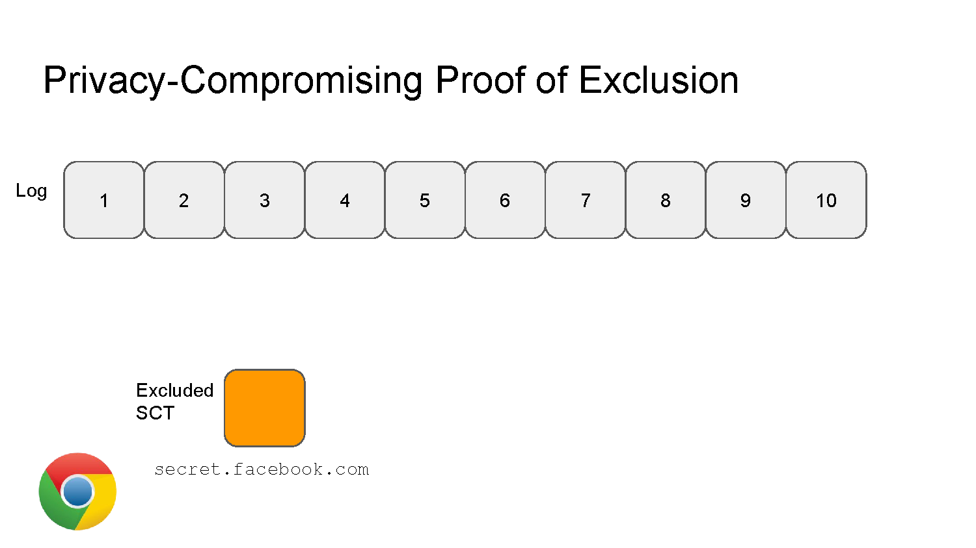
Privacy Preserving Proof of Log Exclusions

Slide 34
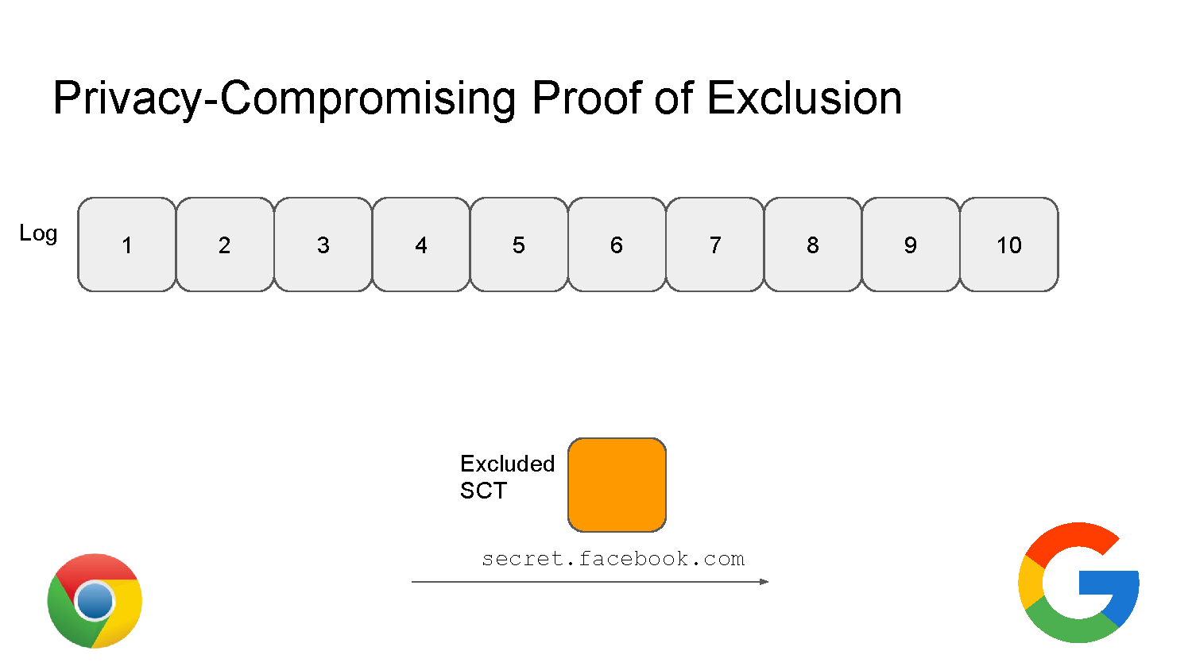
Privacy Preserving Proof of Log Exclusions

Slide 35
Privacy Preserving Proof of Log Exclusions
GOALS
Auditor proves to vendor that an SCT is missing from the log
Auditor does not reveal domain name
Vendor only learns that the log is misbehaving

Slide 36
Privacy Preserving Proof of Log Exclusions
GOALS
Auditor proves to vendor that an SCT is missing from the log
Auditor does not reveal domain name
Vendor only learns that the log is misbehaving
ACTIONS
Vendor can investigate log
Vendor can blindly revoke missing certificate by pushing revocation to all browsers

Slide 37
Privacy Preserving Proof of Log Exclusions
Assumption: Timestamps are in order

Slide 38
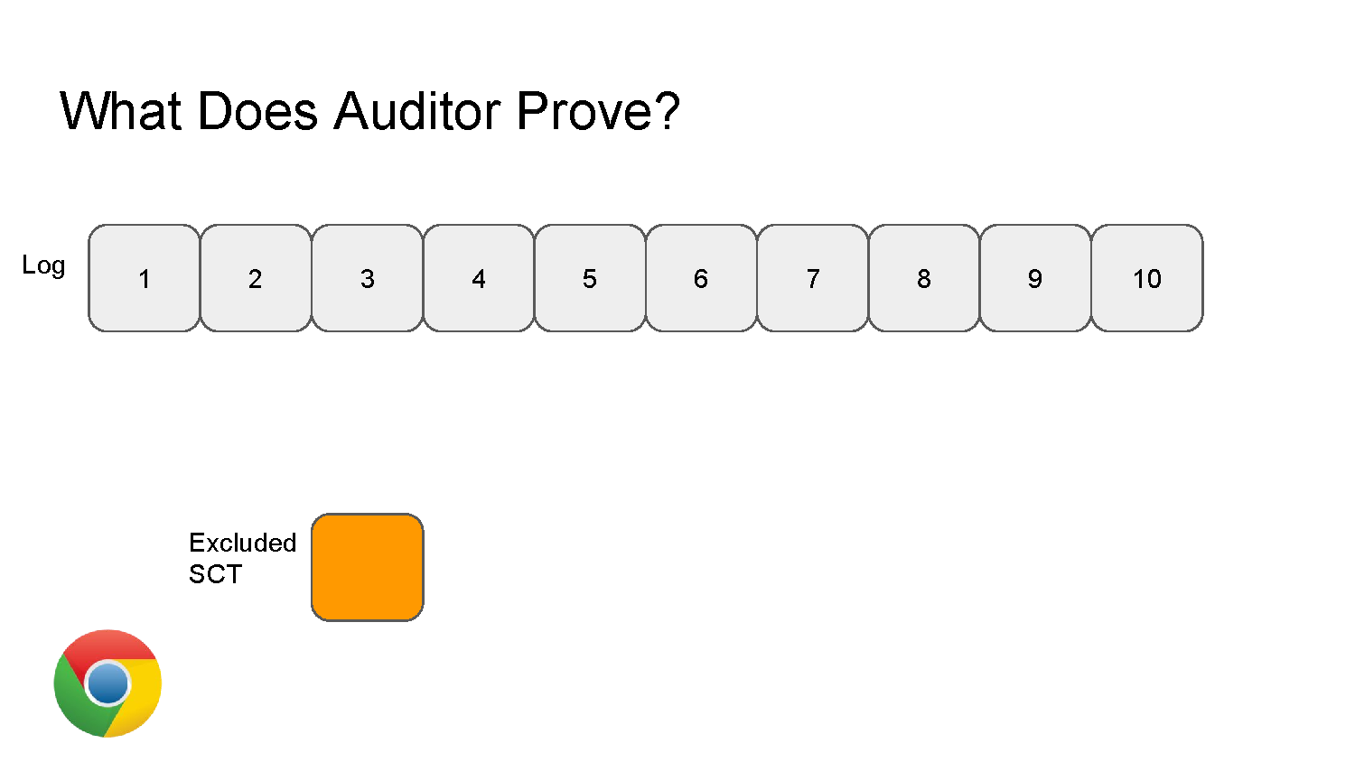
Privacy Preserving Proof of Log Exclusions

Slide 39
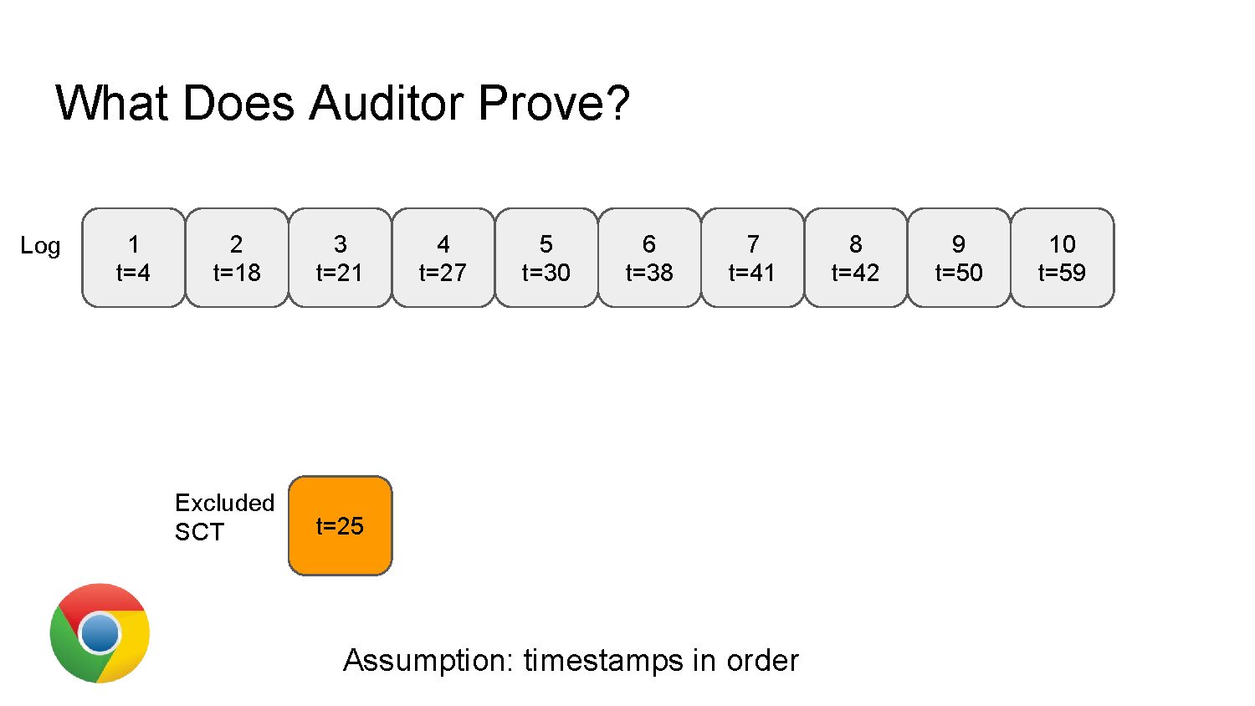
Privacy Preserving Proof of Log Exclusions

Slide 40
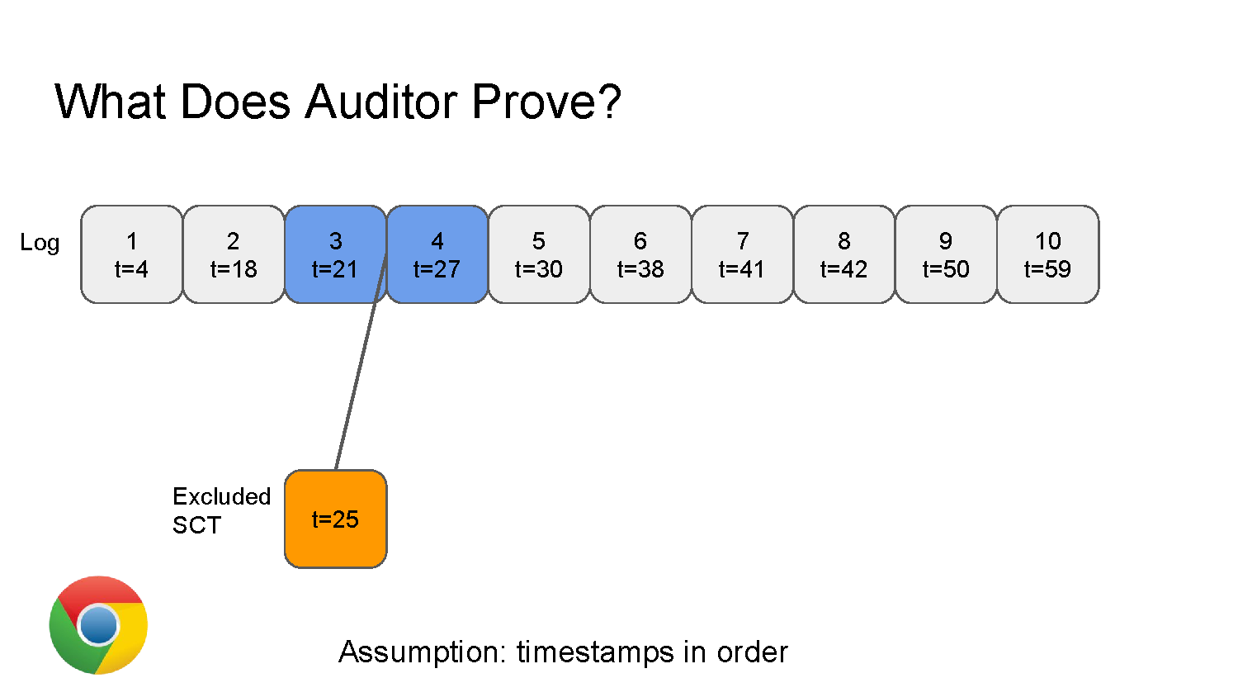
Privacy Preserving Proof of Log Exclusions

Slide 41
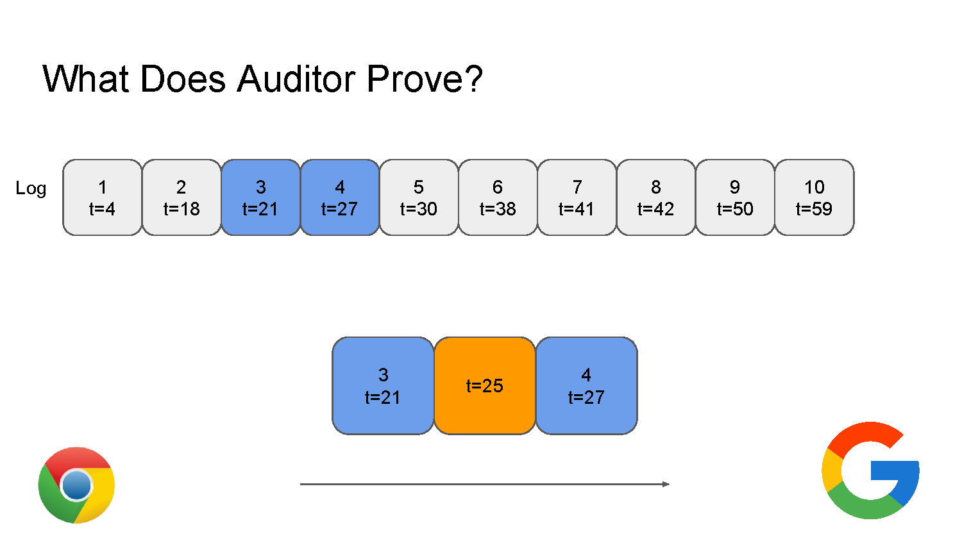
Privacy Preserving Proof of Log Exclusions

Slide 42
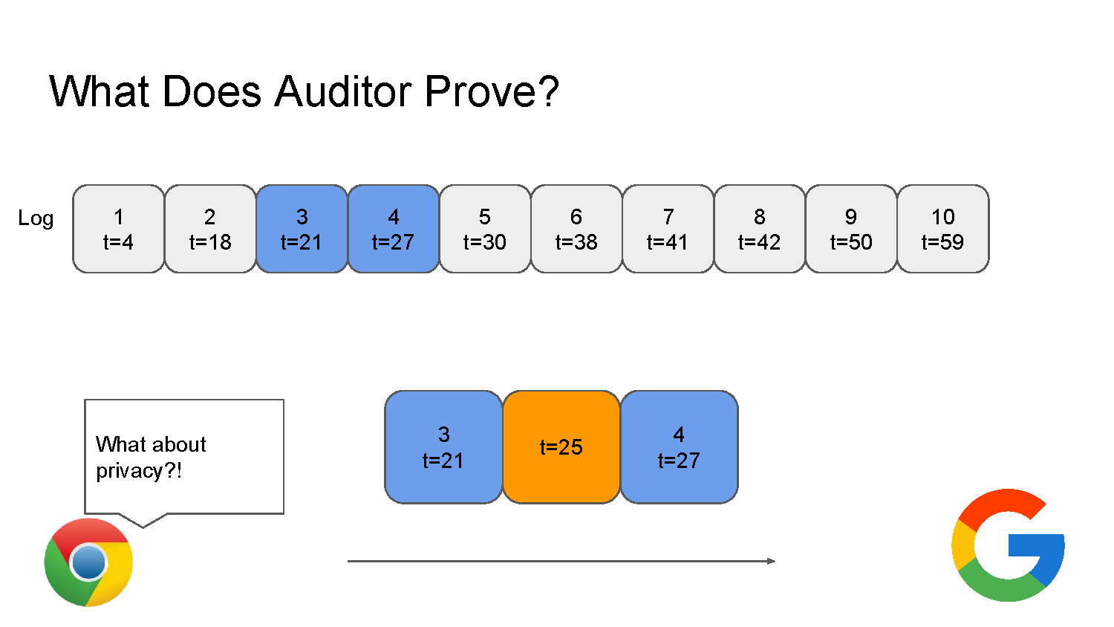
Privacy Preserving Proof of Log Exclusions

Slide 43
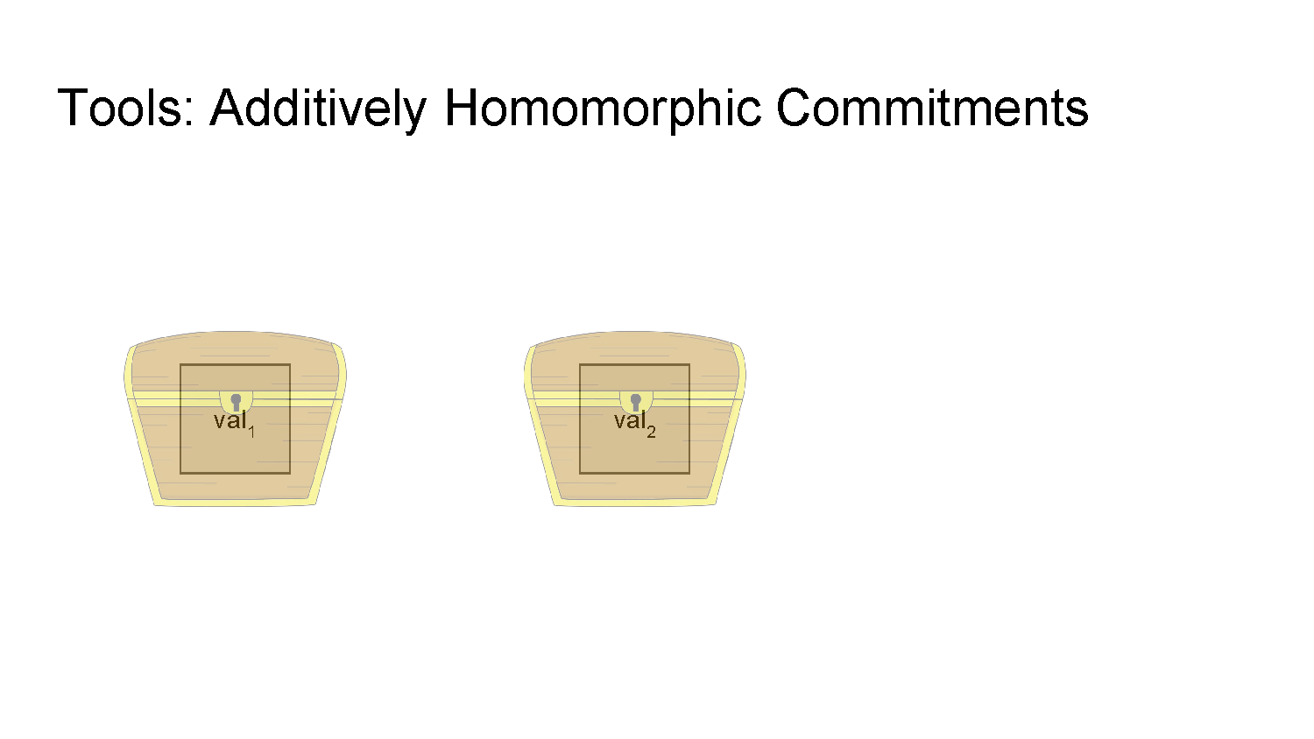
Additively Homomorphic Commitments

Slide 44
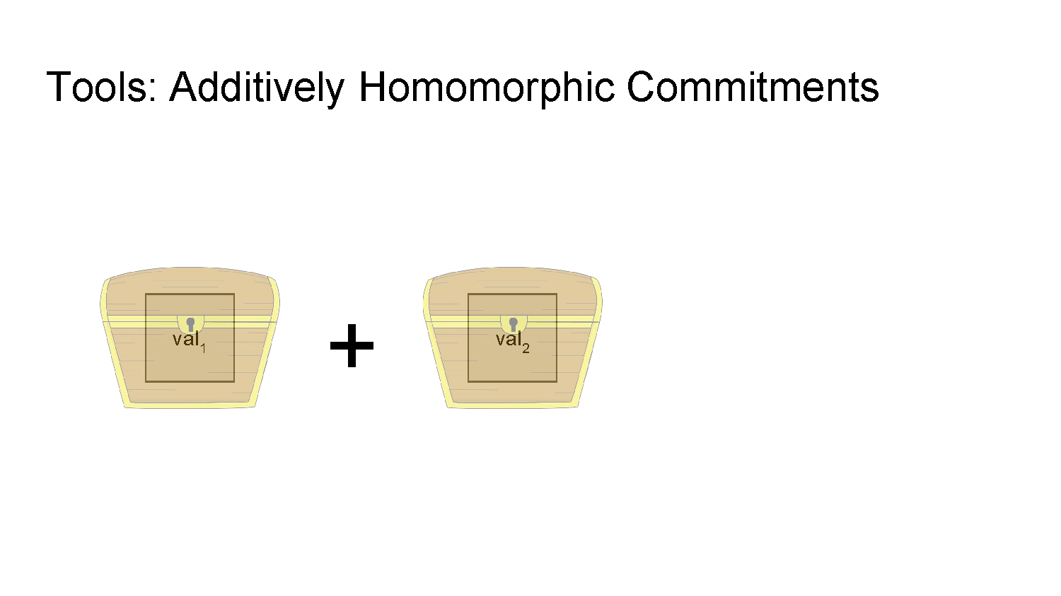
Additively Homomorphic Commitments

Slide 45
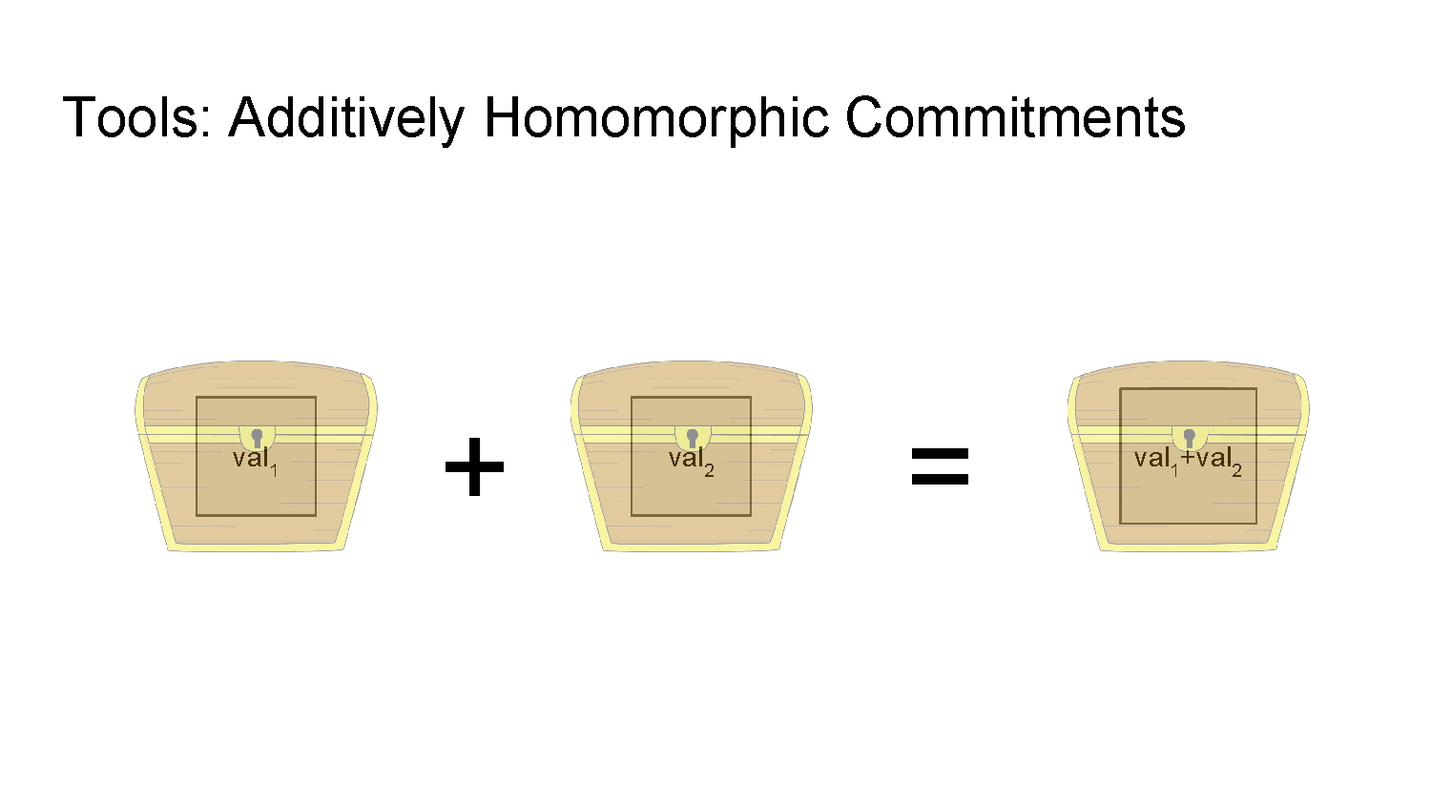
Additively Homomorphic Commitments

Slide 46
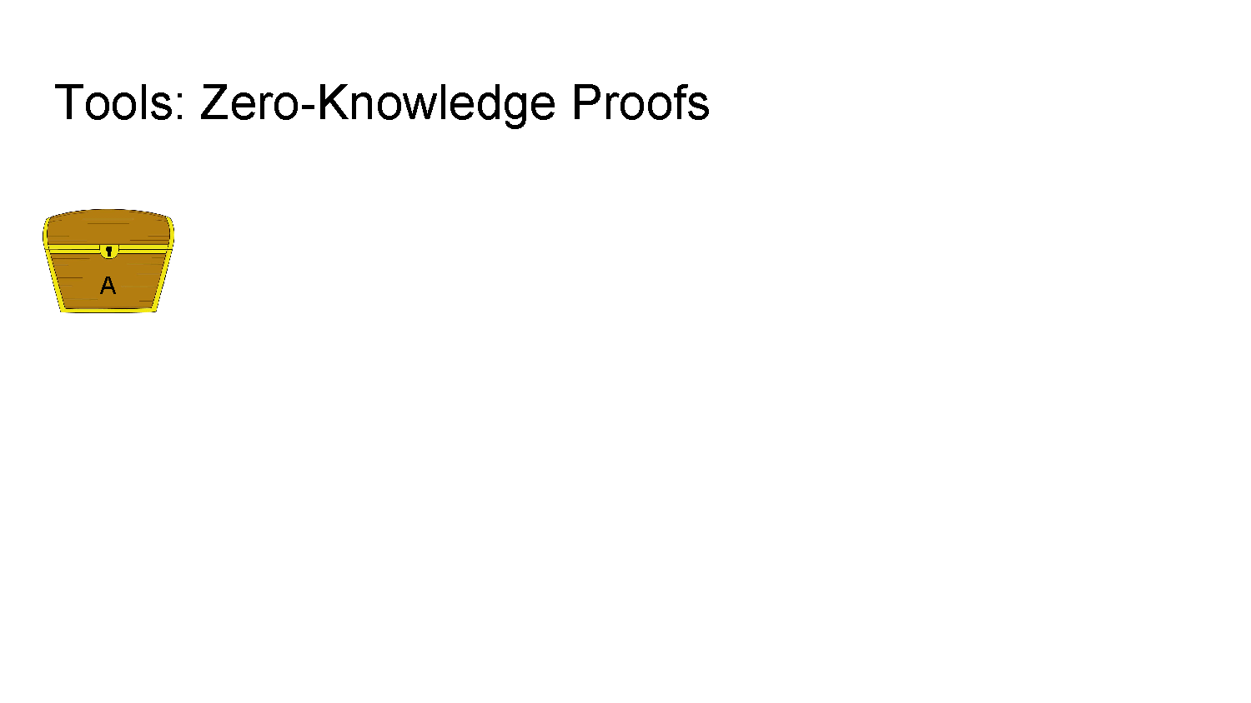
Zero Knowledge Proofs

Slide 47
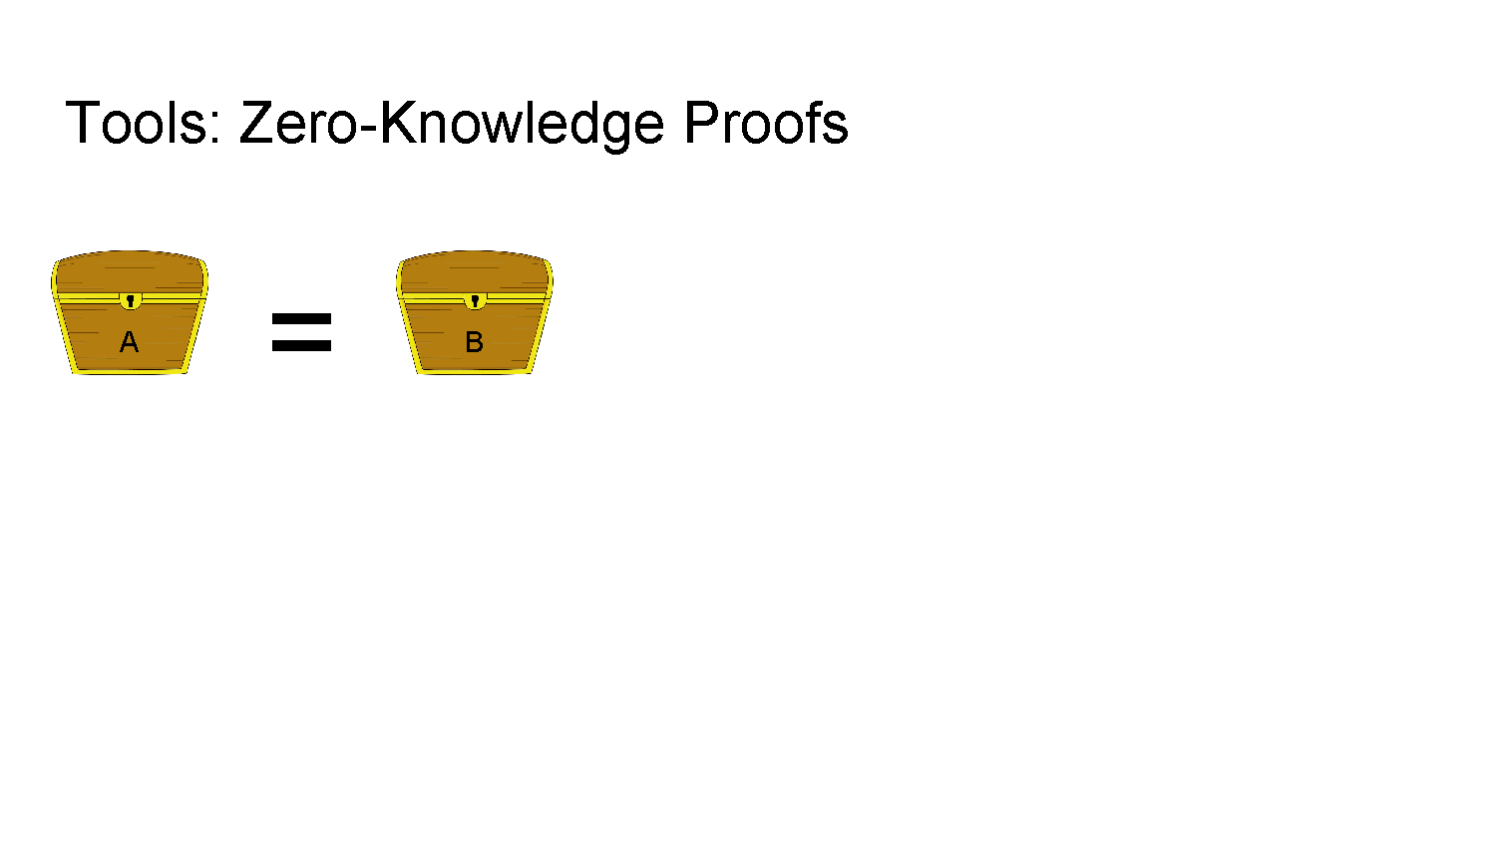
Zero Knowledge Proofs

Slide 48
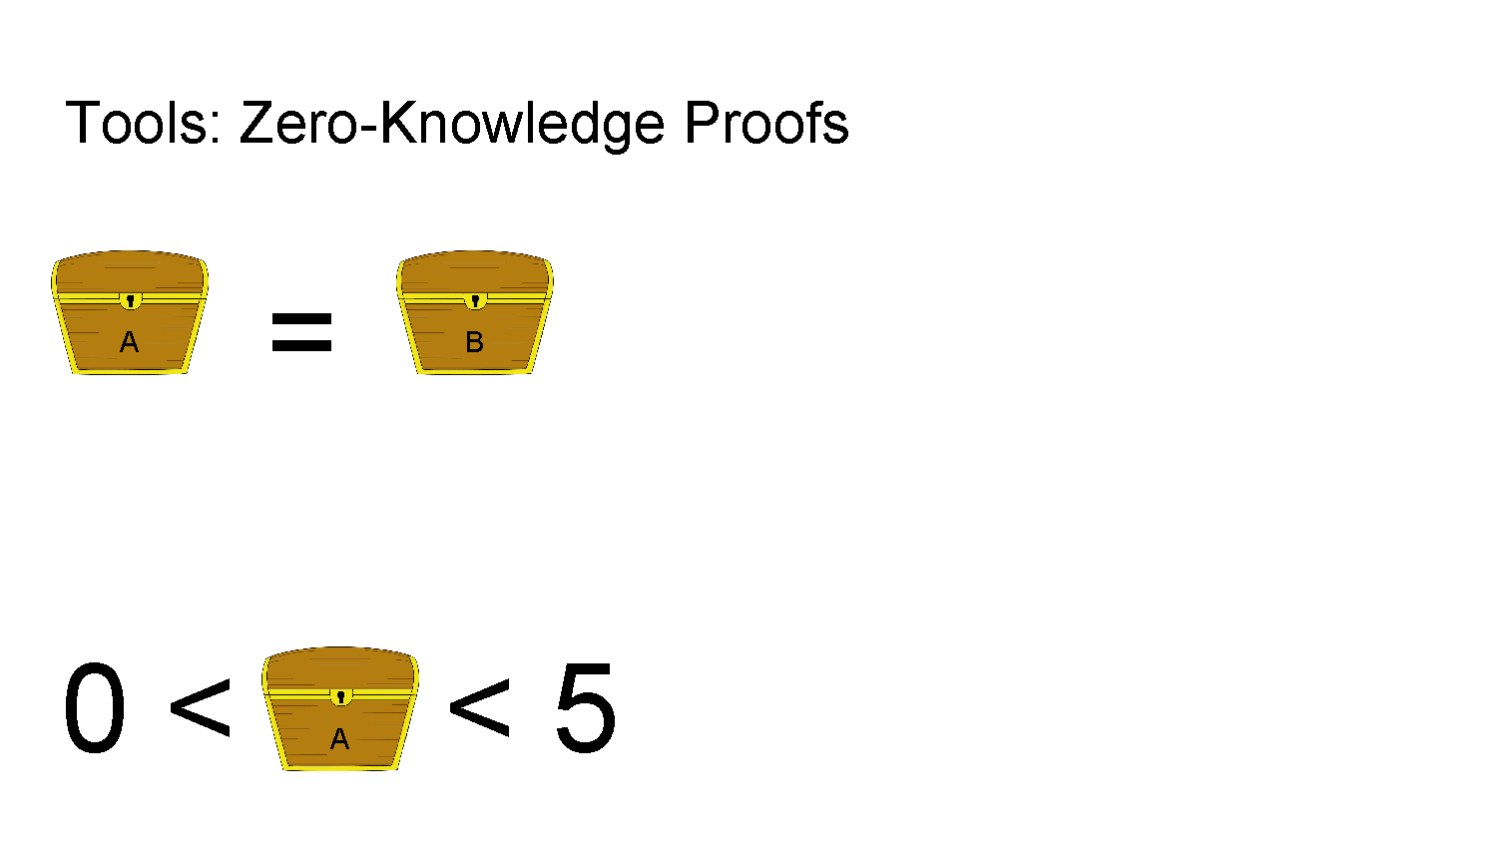
Zero Knowledge Proofs

Slide 49
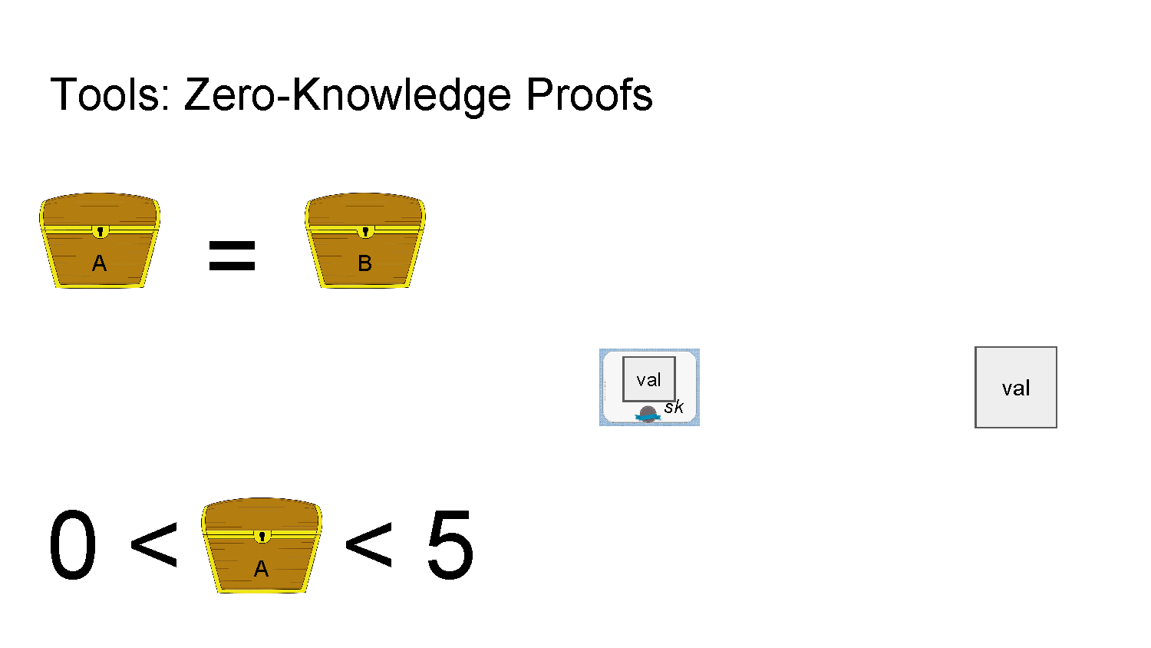
Zero Knowledge Proofs

Slide 50
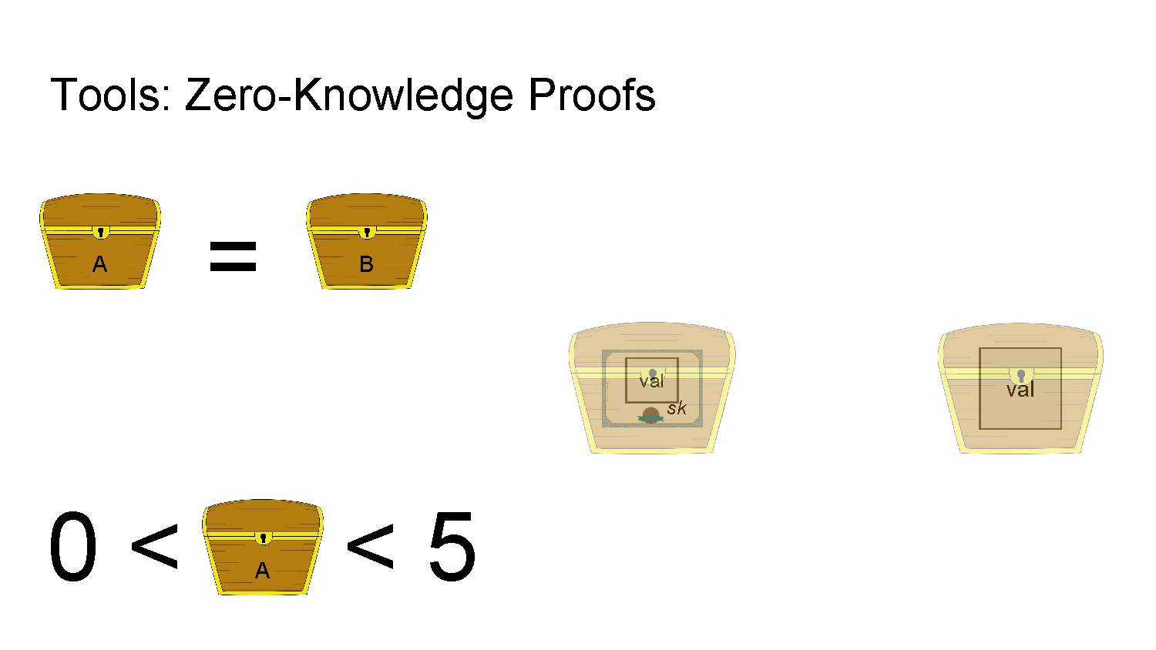
Zero Knowledge Proofs

Slide 51

Zero Knowledge Proofs

Slide 52
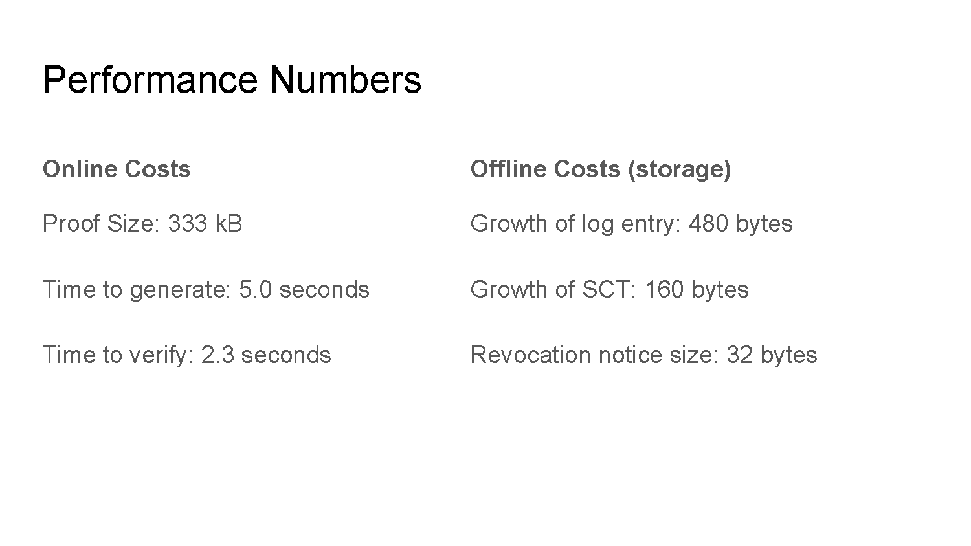
Performance Numbers

Slide 53
Zero Knowledge proofs of exclusion
Zero Knowledge Proofs of Exclusion
Log: The entity managing a CT log and issuing SCTs that must be inserted into the log.
Prover: The auditor, mostly a web browser, that obtained a certificate and SCT while visiting a site, but observed that the certificate data is missing from the log.
Verifier: An authority, such as a vendor like Google, that wants to learn that a log is misbehaving without learning the prover's browsing behavior.

Slide 54
Preliminaries
Preliminaries
Additional Signatures:
Signature schemes with efficient proofs of knowledge of signature.
Near collision-resistant hash functions

Slide 55
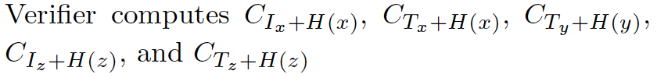
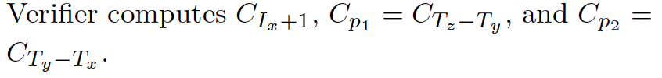
Protocol
Prover
Verifier
Send Commitments
Proves in zero-knowledge
Proves in zero-knowledge

Slide 56
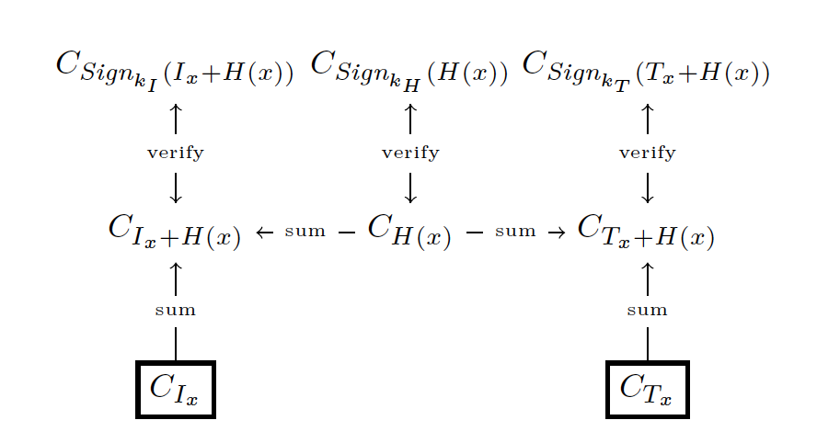
Verified commitments to the Index and Timestamp of a Log entry

Slide 57
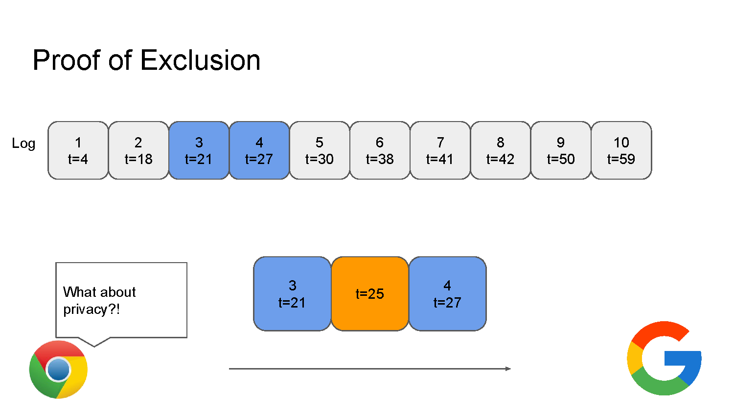
Privacy Preserving Proof of Log Exclusions

Slide 58

Privacy Preserving Proof of Log Exclusions

Slide 59
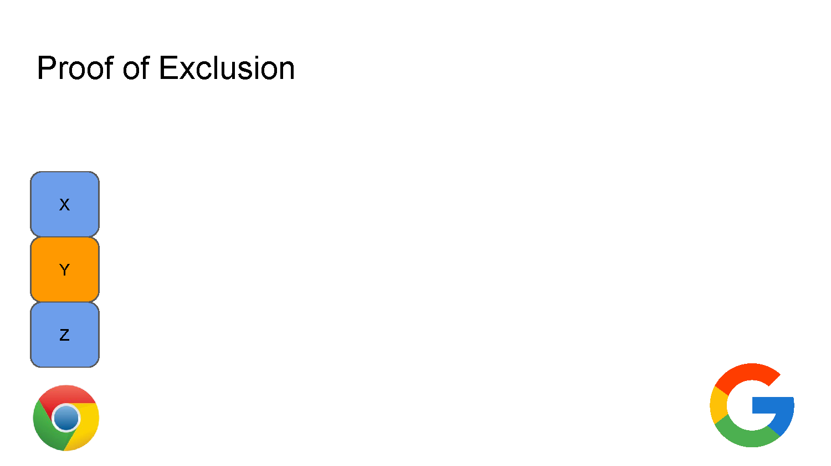
Privacy Preserving Proof of Log Exclusions

Slide 60
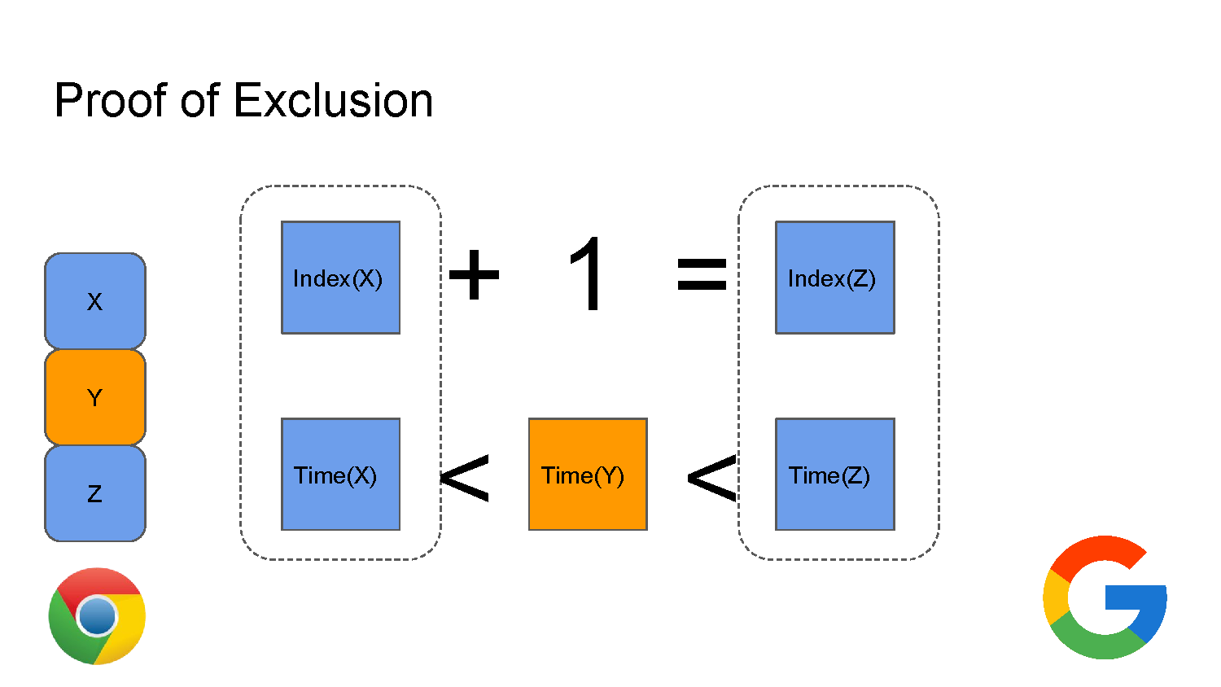
Privacy Preserving Proof of Log Exclusions

Slide 61
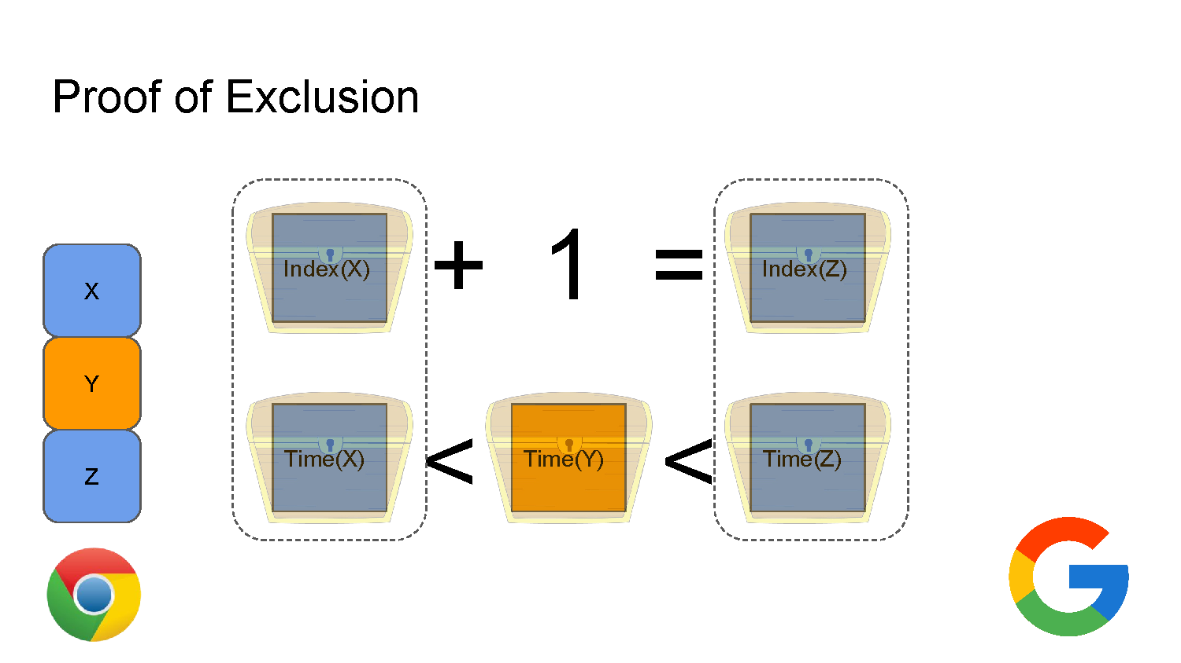
Privacy Preserving Proof of Log Exclusions

Slide 62
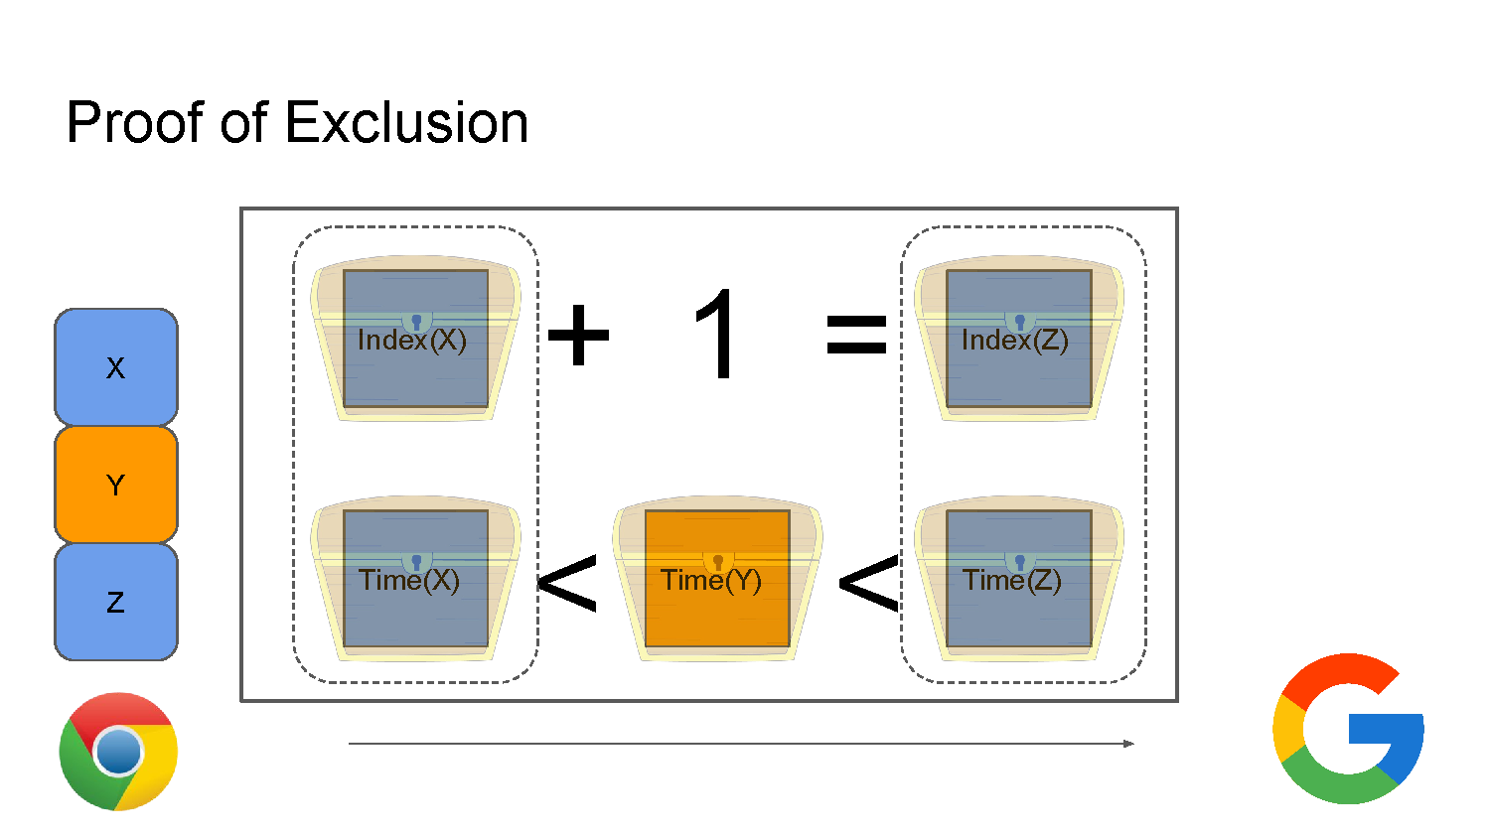
Privacy Preserving Proof of Log Exclusions

Slide 63
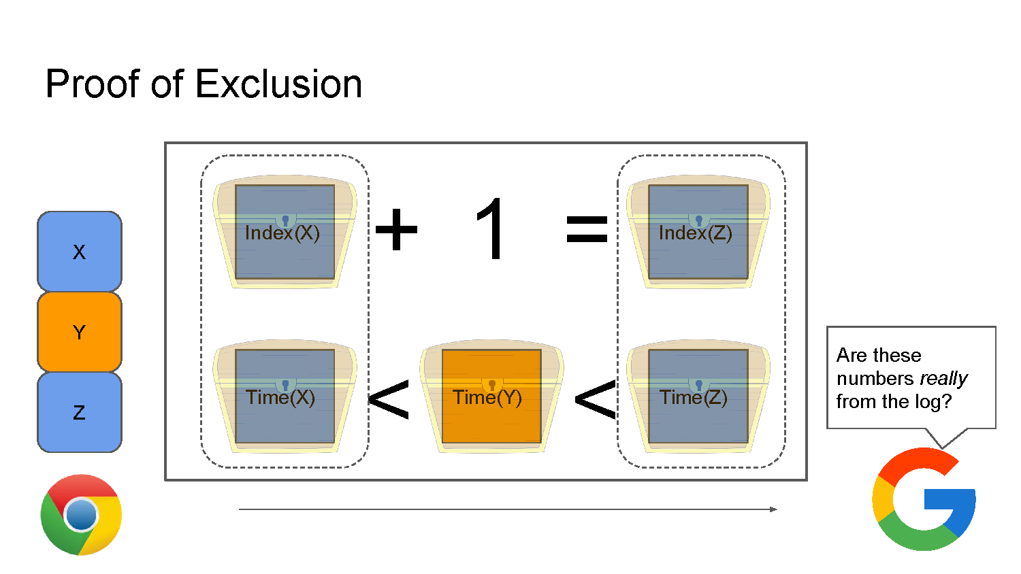
Privacy Preserving Proof of Log Exclusions

Slide 64
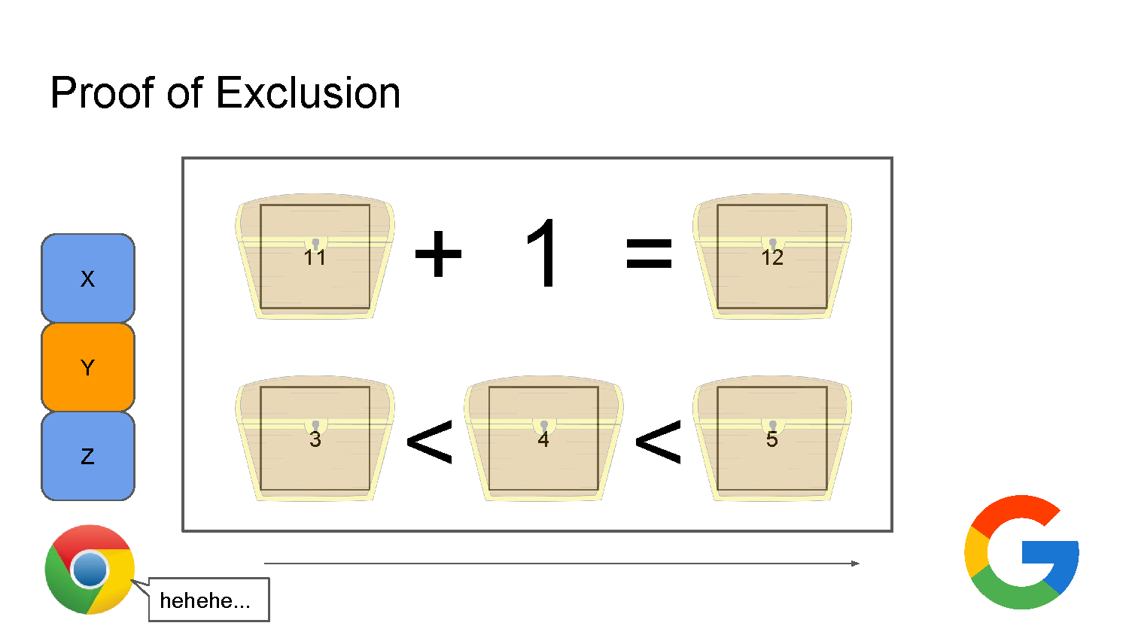
Privacy Preserving Proof of Log Exclusions

Slide 65
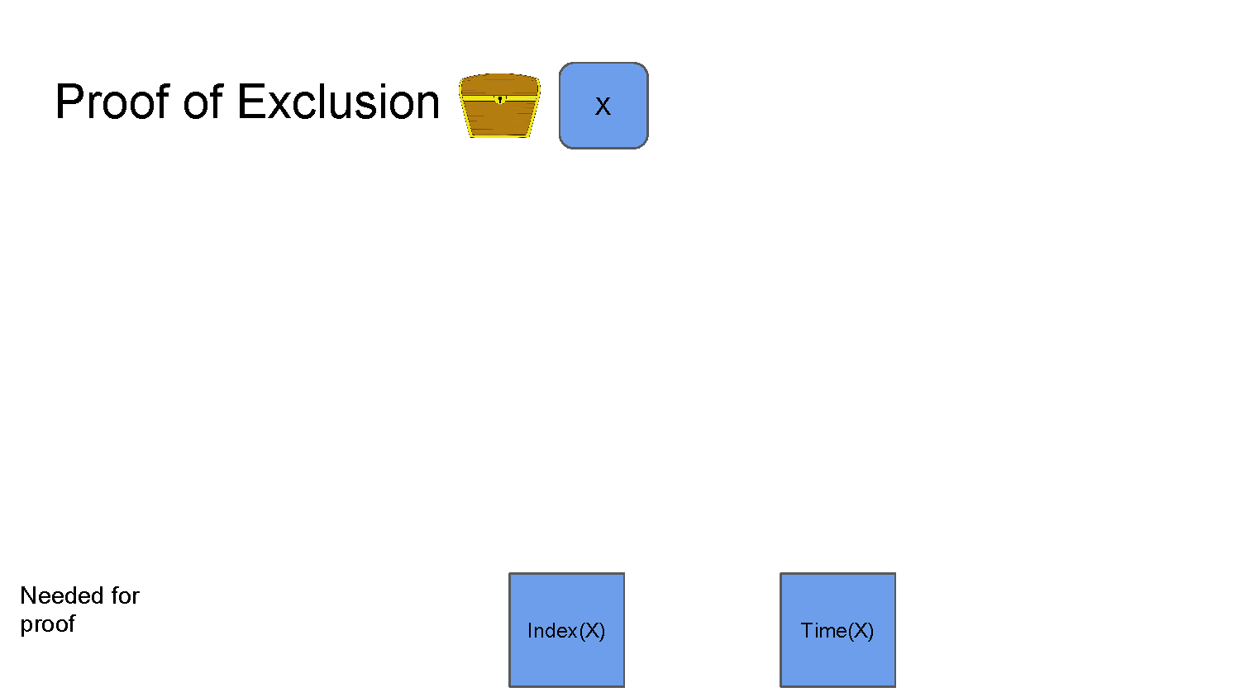
Privacy Preserving Proof of Log Exclusions

Slide 66
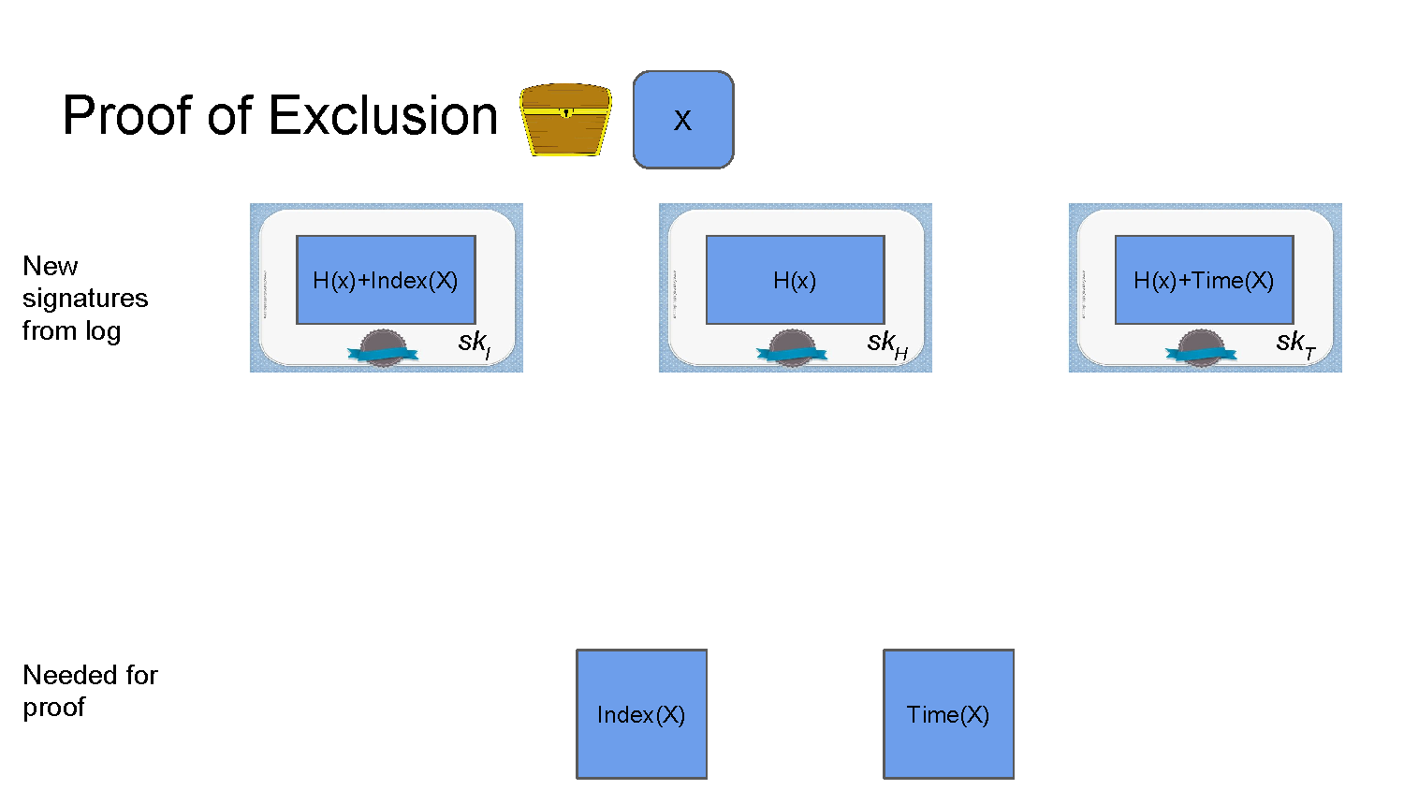
Privacy Preserving Proof of Log Exclusions

Slide 67
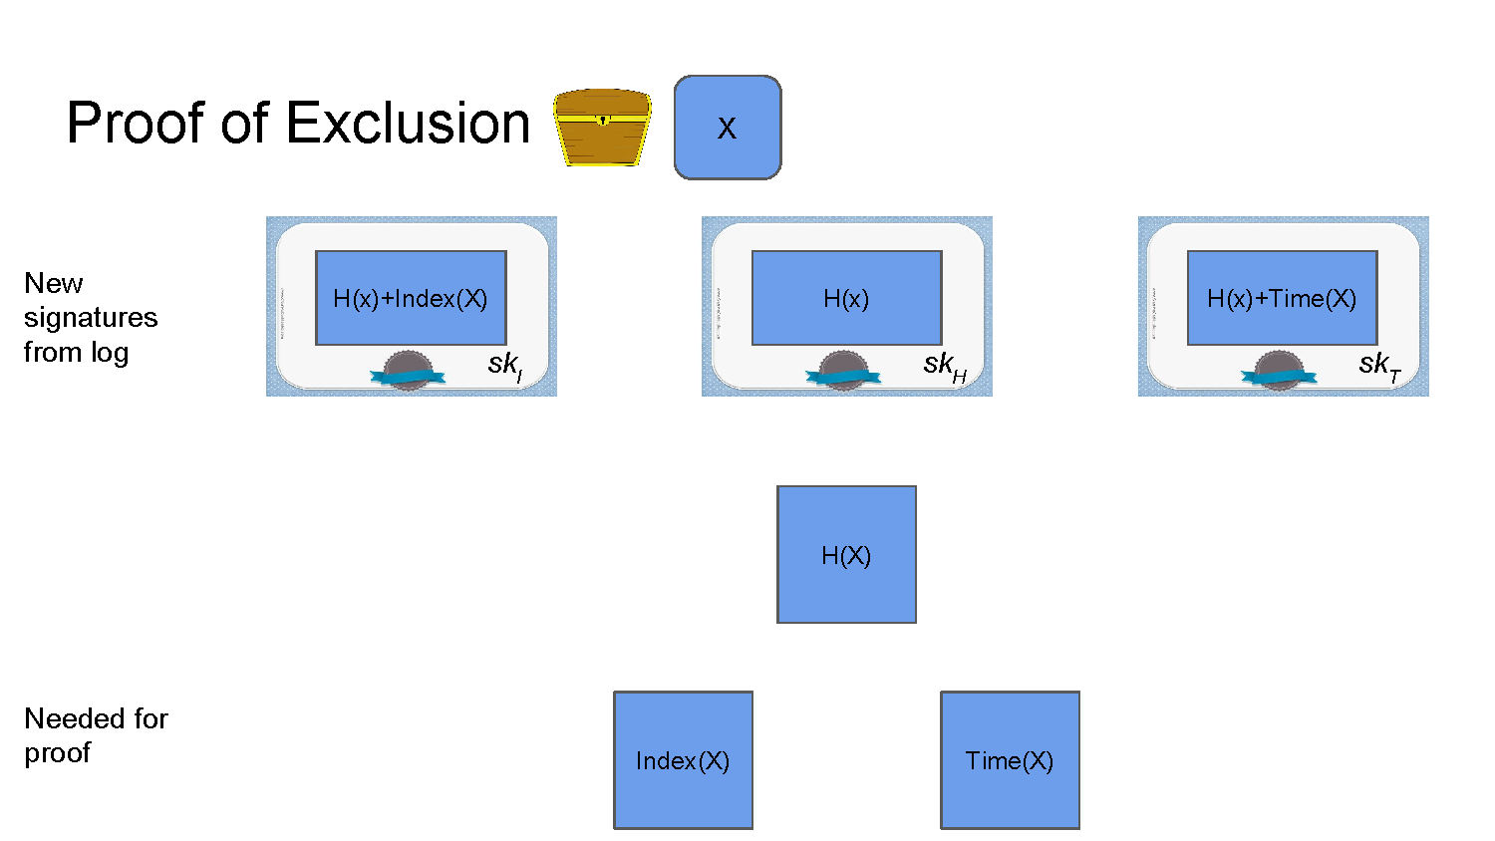
Privacy Preserving Proof of Log Exclusions

Slide 68
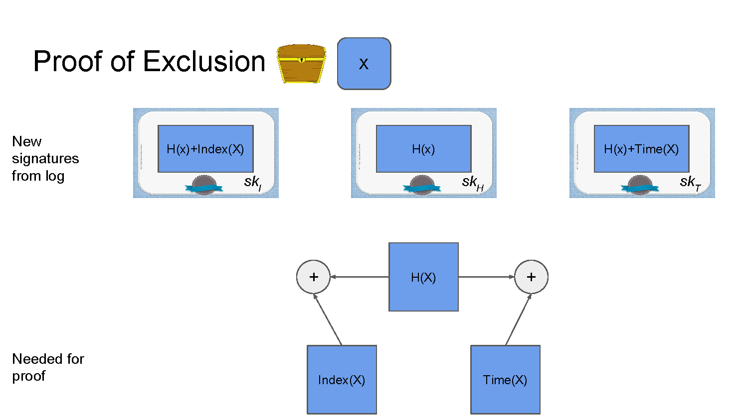
Privacy Preserving Proof of Log Exclusions

Slide 69
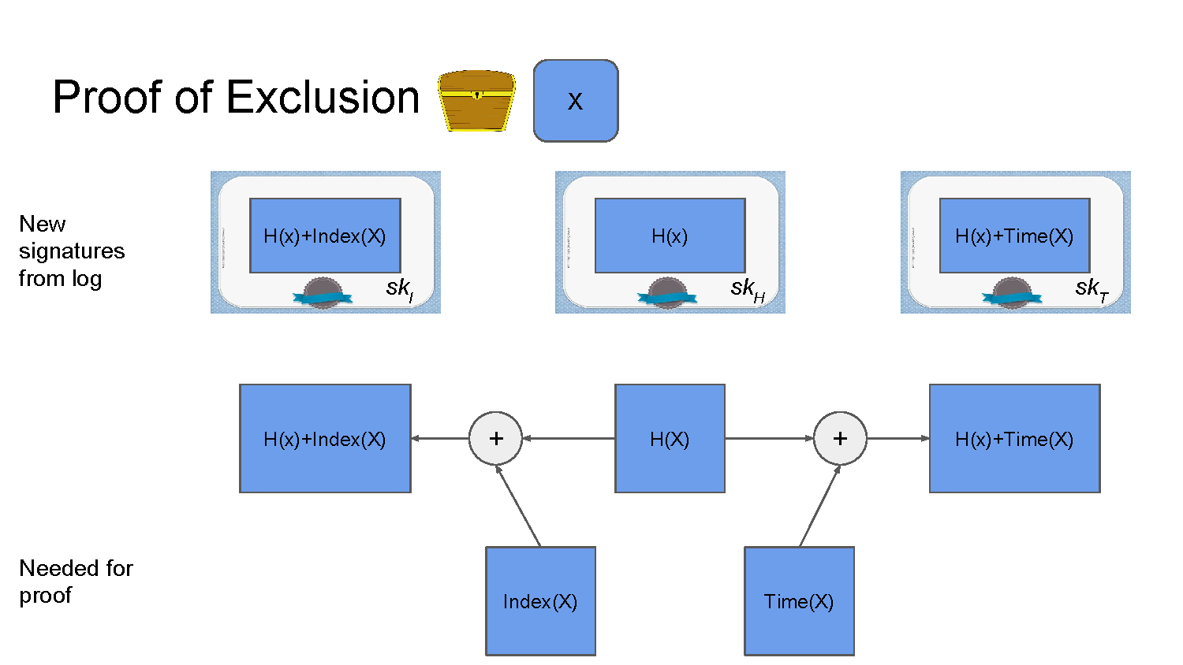
Privacy Preserving Proof of Log Exclusions

Slide 70

Privacy Preserving Proof of Log Exclusions

Slide 71
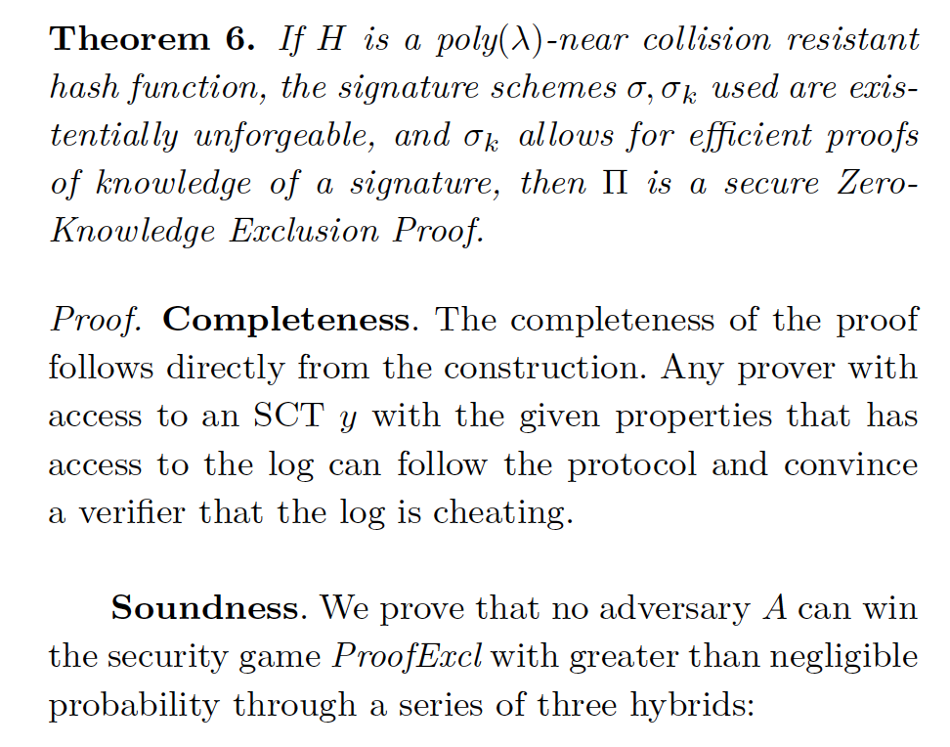
Security Proof
Security Proof

Slide 72
Hybrid
Hybrids
Hybrid 0
Hybrid 1
Hybrid 2

Slide 73
Practical Considerations
Practical Considerations
Key distribution
Obtaining entries around timestamp
Adding signatures in SCT
Uniqueness of timestamps
DOS

Slide 74
OPEN QUESTIONS
Questions
Complete domains hiding
Reduce number of extra signatures
Modifications to CA and logs
Better web of trust
Blockchains

Slide 75
Thank you

